Slide 1
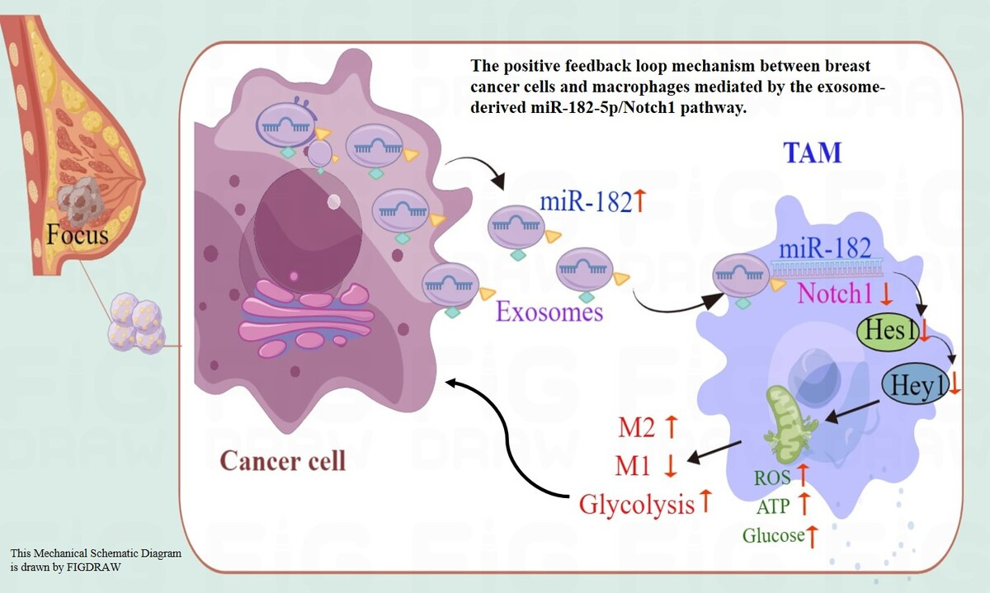

Exosomal miR-182-5p from breast cancer cells reprogram tumor-associated macrophages and promote triple-negative breast cancer progression by targeting Notch1 in macrophages
DOI: 10.5114/aoms/187080
Arch Med Sci 2025;21(4):1471-1486
Notes:
Introduction
The regulatory role of miR-182 in breast cancer malignancy and macrophage reprogramming is well established. However, the mechanisms through which miR-182 overexpression in tumor cells influences macrophage polarization remain elusive.
Material and methods
After transfection with miR-182-5p mimics, inhibitors, and controls for 24 h, exosomes were extracted by differential centrifugation from transfected MDA-MB-231. Macrophages were co-cultured with these exosomes to illustrate the regulative effects of exo-miR-182-5p reprogram macrophage. Furthermore, breast cancer cells were co-cultured with exo-miR-182-5p reprogrammed M2 macrophages to demonstrate the effects of reprogrammed M2 macrophages to influence breast cancer progression. After all, these findings were validated in a cell-derived xenograft (CDX) BALB/C nude-mouse model.
Results
This study demonstrated that exosome-derived miR-182-5p from triple-negative breast cancer (TNBC) cells reprograms M2 macrophage polarization through direct combination with Notch1, thereby enhancing breast cancer progression in vitro and in vivo. When co-cultured with exosomes from TNBC cells transfected with miR-182-5p mimics or inhibitors, macrophages showed altered Notch1/Hes1 pathway expression, leading to M2 polarization and subsequent changes in reactive oxygen species (ROS), inflammation, and other biochemical markers. Furthermore, breast cancer cells co-cultured with exosome-reprogrammed macrophages exhibited increased colony formation, migration, and invasion, as well as reduced apoptosis. These findings were validated in a BALB/C nude-mouse model.
Conclusions
This study pioneers the elucidation of the feedback loop mechanism between breast cancer cells and macrophages mediated by the exosome-derived miR-182-5p/Notch1 pathway, highlighting its role in macrophage reprogramming. Although the therapeutic application of miR-182-5p inhibitors as anticancer agents remains in the early stages, targeting macrophage polarization represents a promising avenue for breast cancer therapy.

