Slide 1
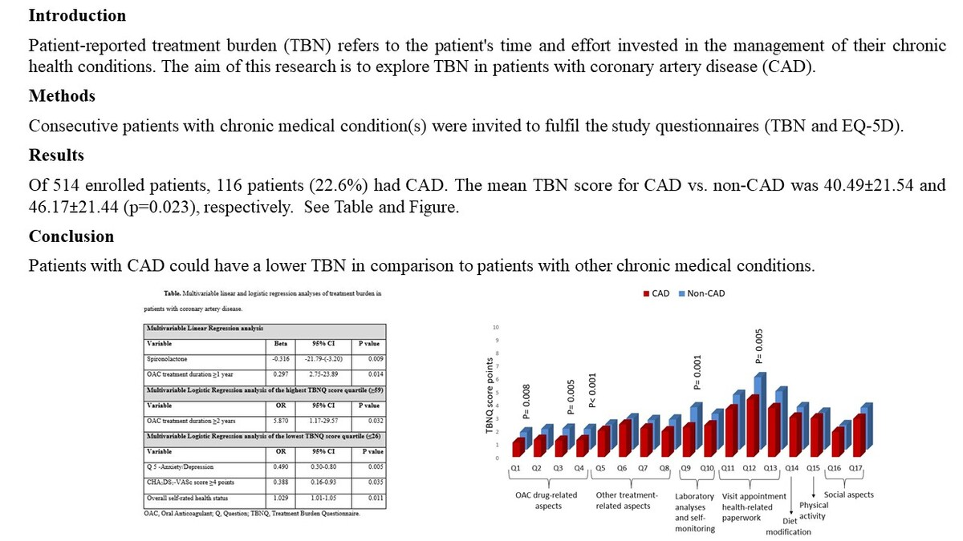

Assessment of patient-reported treatment burden in patients with coronary artery disease
DOI: 10.5114/aoms/187104
Arch Med Sci 2024;20(3):1006-1010
Notes:
Introduction
Patient-reported treatment burden (TBN) refers to the patient’s time and effort invested in the management of their chronic health conditions. The aim of this research was to explore TBN in patients with coronary artery disease (CAD).
Methods
Consecutive patients with chronic medical condition(s) were invited to complete the study questionnaires (TBN and EQ-5D).
Results
Of 514 enrolled patients, 116 (22.6%) patients had CAD. The mean TBN score for CAD vs. non-CAD was 40.49 ±21.54 and 46.17 ±21.44 (p = 0.023), respectively.
Conclusions
Patients with CAD could have a lower TBN in comparison to patients with other chronic medical conditions.

