Slide 1
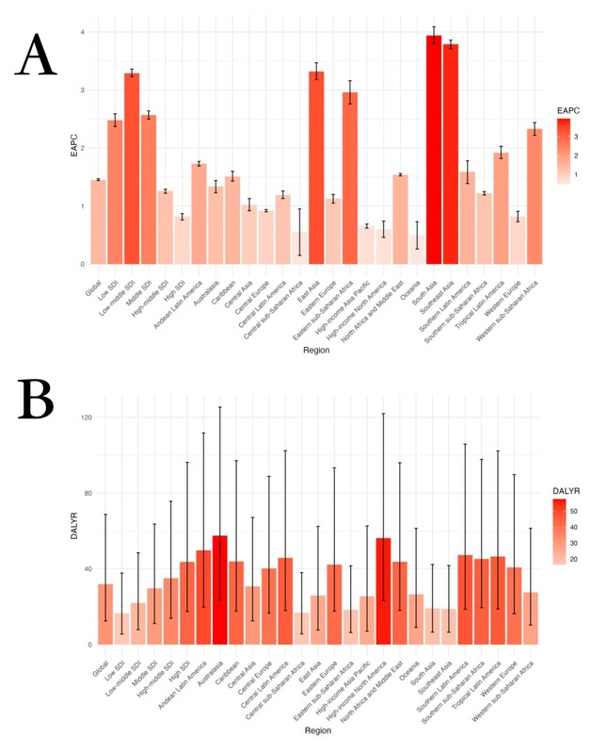

Global burden of osteoarthritis from 1990 to 2019 attributable to high body mass index
DOI: 10.5114/aoms/187150
Arch Med Sci 2024;20(6):1841-1853
Notes:
Introduction
The aim was to examine data from the Global Burden of Disease Study (GBD) 2019 to determine the global burden of osteoarthritis (OA) from 1990 to 2019 that is attributable to high body mass index (BMI).
Material and methods
Disability-adjusted life years (DALYs) and age-standardized DALY rates, and their corresponding estimated annual percentage changes (EAPCs), were used to compare estimated OA burdens between countries and regions. Moreover, a comparative risk assessment framework was used to estimate the risks attributable to high BMI in terms of DALYs.
Results
From 1990 to 2019, the age-standardized DALY rate for OA attributable to high BMI increased significantly (EAPC = 1.45, 95% CI: 1.44–1.47). Moreover, from 1990 to 2019, the age-standardized DALY rate and number of DALYs for OA attributable to high BMI increased less in women than in men. From 1990 to 2019, the age-standardized DALY rate for OA attributable to high BMI increased the most in South Asia (EAPC = 3.94). From 1990 to 2019, among 204 countries worldwide, the age-standardized DALY rate for OA attributable to high BMI increased the most in Equatorial Guinea (EAPC = 7.42). Also, the burden was higher in high-sociodemographic index (SDI) regions than in low-SDI regions.
Conclusions
The global burden of OA attributable to high BMI increased significantly from 1990 to 2019. In particular, this burden was higher in women than in men; primarily affected middle-aged and older adults; and was generally greater in high-SDI regions than in low-SDI regions.

