Slide 1
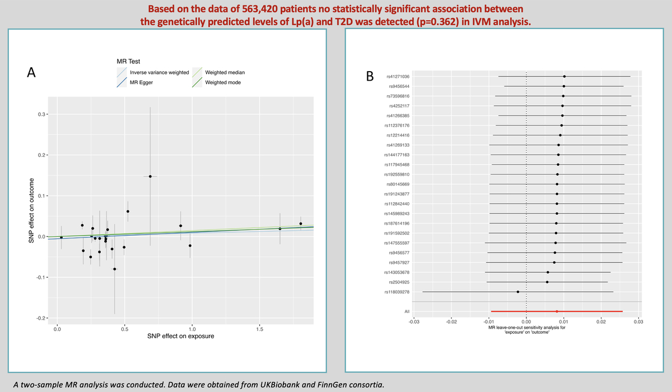

Association between Lp(a) and T2D: a Mendelian randomization study
DOI: 10.5114/aoms/187774
Arch Med Sci 2024;20(3):1002-1005
Notes:
Introduction
Blood lipoprotein(a) (Lp(a)) levels have been observed to be inversely correlated with type 2 diabetes (T2D). In this Mendelian randomization (MR) study, the causal impact of genetically predicted Lp(a) on T2D was assessed.
Methods
A two-sample MR analysis was conducted. Data were obtained from UK Biobank and FinnGen consortia. Primary analysis was based on an inverse-variance-weighted mean (IVM) approach.
Results
No statistically significant association between the genetically predicted levels of Lp(a) and T2D was detected (p = 0.362) in IVM analysis involving data of 563,420 patients.
Conclusions
Genetically predicted Lp(a) concentration does not appear to be causally related to the risk of T2D.

