Slide 1
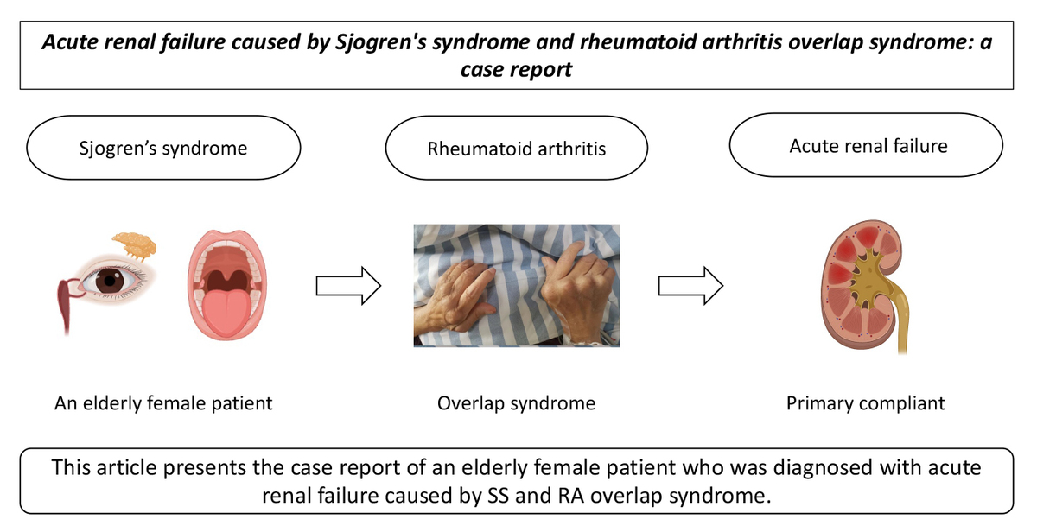

Acute renal failure caused by Sjögren’s syndrome and rheumatoid arthritis overlap syndrome
DOI: 10.5114/aoms/187780
Arch Med Sci 2024;20(3):1034-1037
Notes:
Introduction
Sjögren’s syndrome (SS) and rheumatoid arthritis (RA) are two chronic autoimmune diseases. To date, there have been few reports on the overlap between SS and RA in China, especially regarding correlated acute renal failure cases.
Material and methods
To provide a reference for our clinical peers, this article presents the case report of an elderly female patient who was diagnosed with acute renal failure caused by SS and RA overlap syndrome.
Results
We also provide a relevant analysis of SS and RA overlap syndrome treatment.
Conclusions
We also provide a relevant analysis of SS and RA overlap syndrome treatment.

