Slide 1
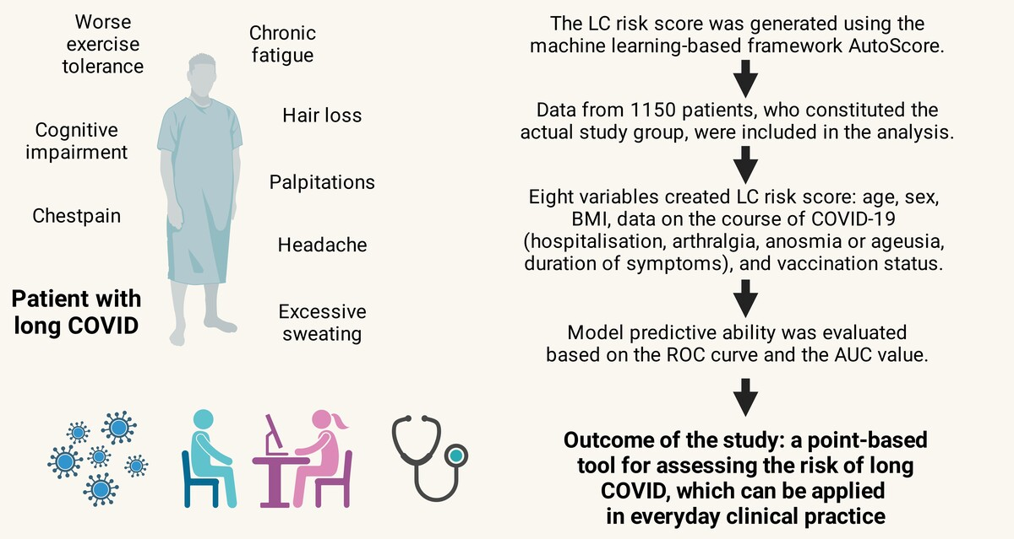

LC risk score – development and evaluation of a scale for assessing the risk of developing long COVID
DOI: 10.5114/aoms/187781
Arch Med Sci 2025;21(1):121-130
Notes:
Introduction
The aim of the study was to create a valuable practical tool for evaluating the risk of developing long COVID.
Material and methods
1150 patients from the Polish STOP-COVID registry (PoLoCOV study) were used to develop the risk score. The patients were ill between 03/2020 and 04/2022. To develop a clinically useful scoring model, the LC risk score was generated using the machine learning-based framework AutoScore. Patient data were first randomised into a training (70% of output) and a test (30% of output) cohort. Due to the relatively small study group, cross-validation was used. Model predictive ability was evaluated based on the ROC curve and the AUC value. The result of the risk score for a given patient was the total value of points assigned to selected variables.
Results
To create the LC risk score, eight variables were ultimately selected due to their significance and clinical value. Female gender significantly contributed to higher final outcome values, with age range 40–49, body mass index < 18.5 kg/m2, hospitalisation during active disease, arthralgia, myalgia as well as loss of taste and smell during infection, COVID-19 symptoms lasting at least 14 days, and unvaccinated status. The final predictive value of the developed LC risk score for a cut-off of 58 points was AUC = 0.630 (95% CI: 0.571–0.688) with sensitivity 39.80%, specificity 85.1%, positive predictive value 80.8%, and negative predictive value 47.3%.
Conclusions
The LC risk score may be a practical and undemanding utility that employs basic sociodemographic data, vaccination status, and symptoms during COVID-19 to assess the risk of long COVID.

