Slide 1
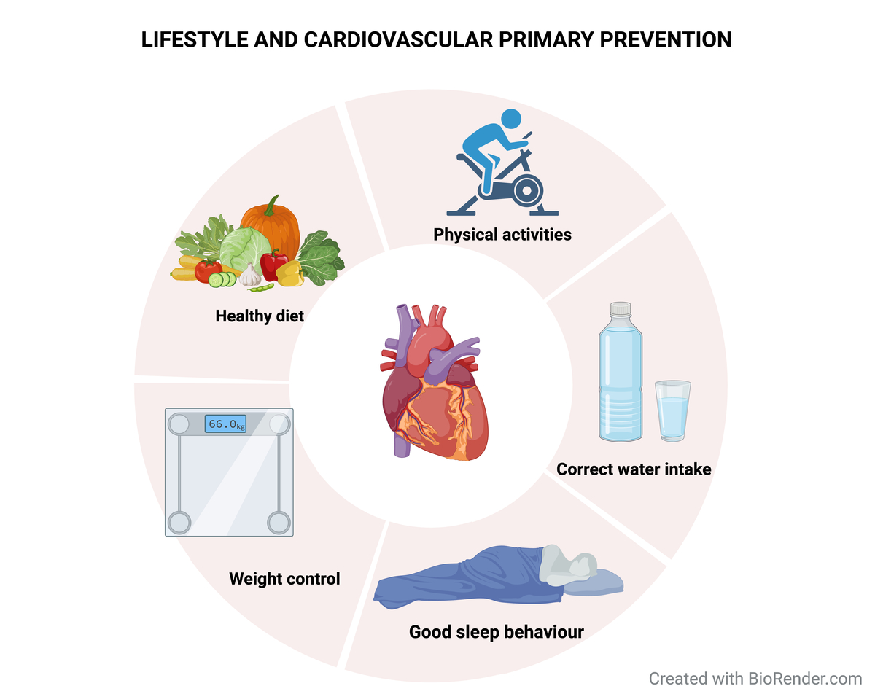

Role of nutrition and healthy lifestyle, for individuals in primary prevention: recent data, gaps in evidence and future directions
DOI: 10.5114/aoms/187841
Arch Med Sci 2024;20(5):1385-1399
Notes:
All recent guidelines on cardiovascular prevention have highlighted the role of a healthy diet and lifestyle advocating an holistic approach to reduce the cardiovascular burden among the population. Despite these efforts, registries have reported that only a minority of healthcare professionals provide advice on diet and lifestyle, and, in most cases, counseling is suboptimal for several reasons. Cardiovascular benefits linked to lifestyle and nutrition seem to be underestimated by many patients and doctors. This overview aims to summarize well-established benefits related to lifestyle and nutrition, discuss the current debates in this field in order to improve awareness among the medical community and promote better implementation of non-pharmaceutical measures to prevent the occurrence of atherothrombotic events, by reducing cardiovascular risk factors such as hypertension, diabetes, dyslipidemia, and obesity.

