Slide 1
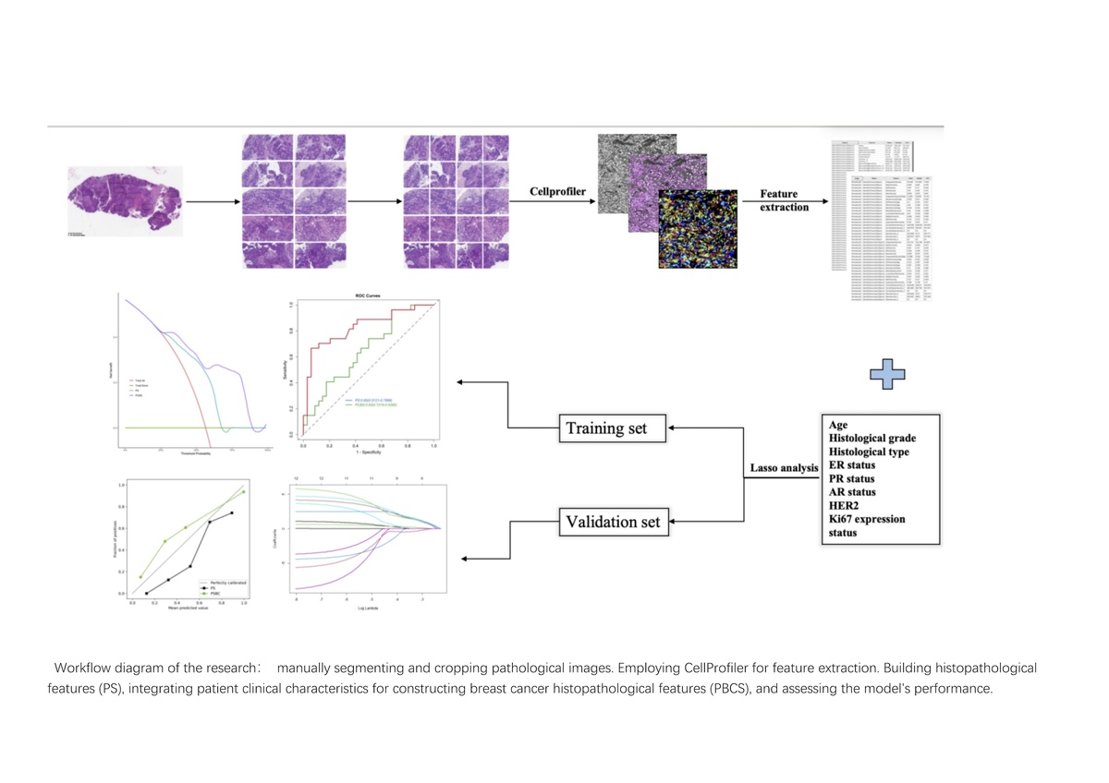

Development and validation of a pathological model predicting the efficacy of neoadjuvant therapy for breast cancer based on RCB scoring
DOI: 10.5114/aoms/188006
Arch Med Sci 2025;21(1):92-101
Notes:
Introduction
Breast cancer has become the most prevalent malignant tumor among women globally, posing a serious threat to women’s life and health. Neoadjuvant therapy (NAT) has emerged as one of the standard treatment approaches for breast cancer patients. However, due to varying responses to NAT among different patients, significant differences in treatment effectiveness occur, impacting the timely alteration of treatment strategies for patients.
Material and methods
This study included a total of 201 breast cancer patients who completed NAT, divided into a training group of 140 cases and a validation group of 61 cases. Based on clinical and pathological characteristics along with the Residual Cancer Burden (RCB) score, we utilized a support vector machine (SVM) algorithm to construct a Pathomics Breast Cancer Signature (PBCS) prediction model. We thoroughly validated the PBCS and compared it to a Pathomics Signature (PS) prediction model.
Results
In our study, we used CellProfiler to extract nine pathological features highly correlated with patients’ RCB scoring from HE-stained slides of breast cancer NAT. Employing the SVM algorithm, we developed a pathological prediction label, named PS. Subsequently, through univariate and multivariate analysis, we discovered a significant correlation between HER2 and the patients’ RCB scores. Integrating HER2 into PS, we constructed a breast cancer pathological prediction model, named PBCS. PBCS exhibits good performance in predicting the effectiveness of postoperative therapy (RCB 0–I) in both the training sets (AUC = 0.86 [95% CI: 0.7988–0.9173]) and validation sets (AUC = 0.83 [95% CI: 0.7219–0.9382]). In the validation set, PBCS significantly outperforms the PS (AUC = 0.65 [95% CI: 0.5121–0.7886]). Calibration curves and clinical decision curves also strongly support PBCS’s ability to effectively predict the efficacy of therapy (RCB 0–I).
Conclusions
PBCS can assist clinical and pathological physicians in accurately predicting patients’ post-treatment RCB grading before initiating NAT. This offers a new approach to forecast breast cancer patients’ responsiveness to NAT, aiding in devising personalized treatment strategies for patients.

