Slide 1
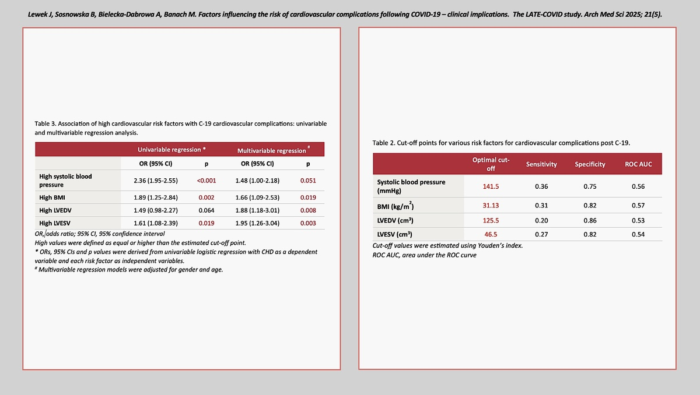

Factors influencing the risk of cardiovascular complications following COVID-19 – clinical implications. The LATE-COVID study
DOI: 10.5114/aoms/188090
Arch Med Sci 2025;21(6):2882-2887
Notes:
Introduction
Material and methods
Results
Conclusions

