Slide 1
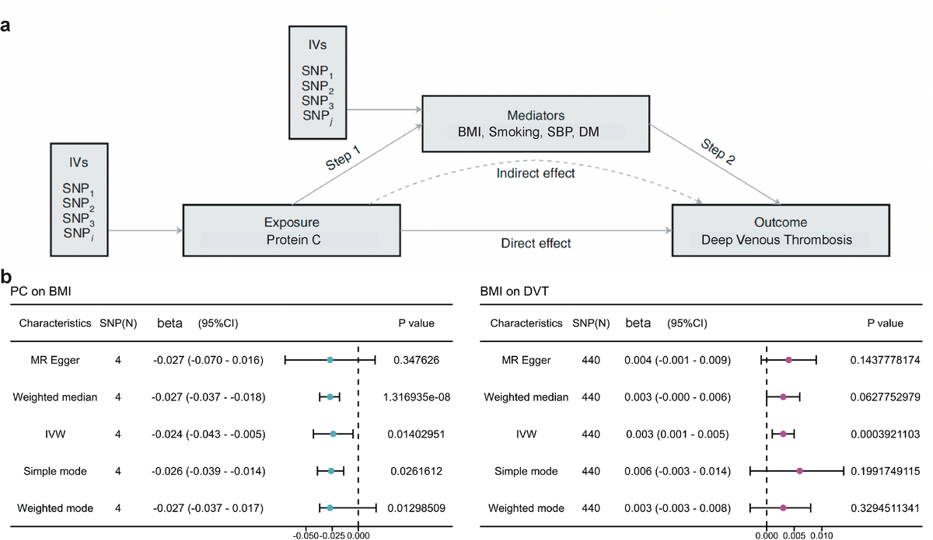

Bidirectional two-sample Mendelian randomization analysis identifies protein C rather than protein S or antithrombin-III as associated with deep venous thrombosis
DOI: 10.5114/aoms/188205
Arch Med Sci 2025;21(1):215-223
Notes:
Introduction
Observational studies have indicated significant contributions of protein C and protein S to thrombotic diseases, yet the “anticoagulation paradox” in deep venous thrombosis (DVT) remains unresolved. Therefore, we conducted an investigation to discern the causal effects of protein C, protein S and antithrombin-III on DVT risk.
Material and methods
We employed a two-sample (one to evaluate the gene-exposure relationship and the other to evaluate the gene-outcome relationship) bidirectional Mendelian randomization (MR) framework to assess the causal associations between protein C, protein S, antithrombin-III and DVT.
Results
Genetic associations with DVT were extracted from a comprehensive genome-wide association study involving 484,598 individuals. In the multivariable MR analysis, the odds ratios for DVT per standard deviation (SD) increase were 1.005 (95% CI: 1.002–1.008; <i>p</i> < 0.001) for protein C, 0.997 (95% CI: 0.992–1.001; <i>p</i> = 0.146) for protein S, and 1.001 (95% CI: 0.998–1.005; <i>p</i> = 0.456) for antithrombin-III. A two-step MR mediation analysis revealed that the association between protein C and DVT was partially mediated by body mass index, with a mediated proportion of 11.4% (95% confidence interval, 2.3% to 79.2%).
Conclusions
These findings provide insights into the genetic relationship between relative protein C rather than protein S or antithrombin-III levels and DVT, offering potential utility in identifying at-risk patients for DVT development.

