Slide 1
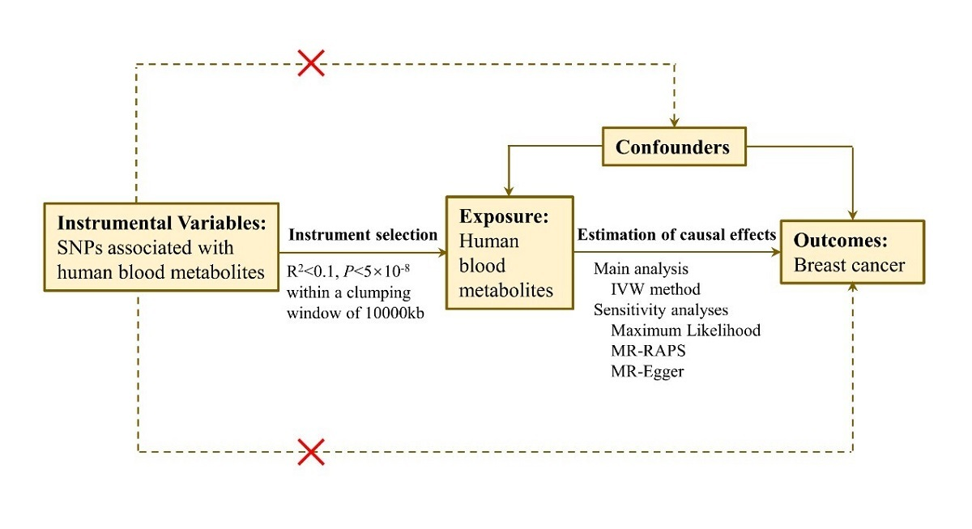

Causal associations between blood metabolites and breast cancer
DOI: 10.5114/aoms/188275
Arch Med Sci 2025;21(1):206-214
Notes:
Introduction
The associations between blood metabolites and breast cancer remain unclear. We conducted a systematic two-sample Mendelian randomization (MR) analysis to identify key human blood metabolites and potential biomarkers for breast cancer development.
Material and methods
The data were extracted from large-scale genome-wide association study (GWAS) public databases. Instrumental variables were selected from a cohort study of 453 metabolic profiles from 7,824 participants. Breast cancer incidence data were obtained from a large cohort study involving 138,389 cases and 240,341 controls. Causal associations between human blood metabolites and breast cancer incidence were assessed using inverse-variance weighting, and MR-Egger regression.
Results
Five human blood metabolites were identified as biomarkers for breast cancer: serine (OR = 2.25; 95% CI: 1.18–4.27), 10-undecenoate (11:1n1) (OR = 1.38; 95% CI: 1.00–1.90), X-12696 (OR = 2.15; 95% CI: 1.14–4.08), X-14626 (OR = 1.68; 95% CI: 1.15–2.46), and succinyl carnitine (OR = 1.58; 95% CI: 1.06–2.34). The sensitivity analysis results indicate no pleiotropy between the metabolites and breast cancer risk, confirming the robustness of the findings.
Conclusions
This study in metabolomics research identified five human blood metabolites – serine, 10-undecenoate (11:1n1), X-12696, X-14626, and succinylcarnitine – as potential biomarkers for assessing breast cancer risk. Among these metabolites, serine and X-12696 showed the strongest associations with the likelihood of developing breast cancer.

