Slide 1
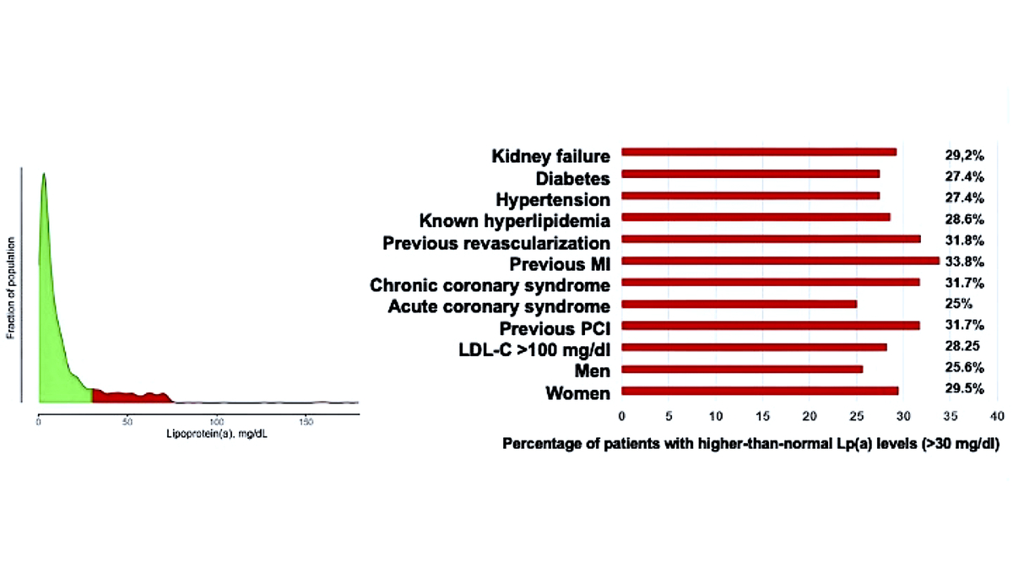

Lipoprotein(a) and its impact on cardiovascular disease – the Polish perspective: design and first results of the Zabrze-Lipoprotein(a) Registry
DOI: 10.5114/aoms/188294
Arch Med Sci 2024;20(4):1069-1076
Notes:
Introduction
Lipoprotein(a) [Lp(a)] is an independent risk factor for atherosclerotic cardiovascular disease (ASCVD). Increased Lp(a) concentration > 30 mg/dl (75 nmol/l) and especially >50 mg/dl (125 nmol/l) may cause faster atherosclerosis, being an important and underdiagnosed residual cardiovascular risk factor. Thus, there is a need to characterize further the clinical phenotypes in patients at risk for ASCVD with high Lp(a) levels now and during follow-up, while also looking for the possible impact of geographical differences.
Material and methods
The Zabrze Lipoprotein(a) Registry (Zabrze-Lip(a)R) was founded on the basis of data from 2,001 consecutive patients with very high cardiovascular risk treated in a tertiary hospital. The registry patients will be followed for at least 5 years with the possibility of extending this period as an open label study. All-cause and cause-specific mortality, hospitalizations, and cardiovascular events, such as myocardial infarction (MI) and stroke, will be assessed.
Results
The mean age of patients was 66.4 years (females 37.1%). The median Lp(a) concentration in the entire population was 6.6 mg/dl (16.5 nmol/l) (mean: 14.3 ±19.4 mg/dl). 540 (27%) patients had elevated Lp(a) levels above 30 mg/dl (75 nmol/l); they were significantly older (68.8 vs. 66.3 years; p = 0.04), had significantly lower hemoglobin and hematocrit, and higher platelet count and levels of NT-proBNP and C-reactive protein. The prevalence of elevated Lp(a) > 30 mg/dl (75 nmol/l) concentrations was very high in patients with a chronic coronary syndrome (CCS) (52.2% (282/540) vs. 41.5% (607/1461); p < 0.001), in patients undergoing PCI during hospitalization (23.9 vs. 19%; p = 0.01), and in patients with previous MI (20.6% vs. 14.9%; p = 0.0022). In the multivariable analysis, the independent predictors of elevated Lp(a) > 30 mg/dl (75 nmol/l) were only lower Hb values (OR = 0.925; 95% CI: 0.874–0.978; p = 0.006) and higher platelet count (1.002; 95%CI: 1.000–1.003; p < 0.02).
Conclusions
In Poland, the largest representative of Central and Eastern European countries, 27% of patients at very high cardiovascular risk with established ASCVD experience additional risk related to an elevated Lp(a) level, with every second patient having CCS. Interestingly, only two factors were significantly related to elevated Lp(a) levels: lower Hb values and higher platelet count. However, the clinical relevance of these results needs confirmation.

