Slide 1
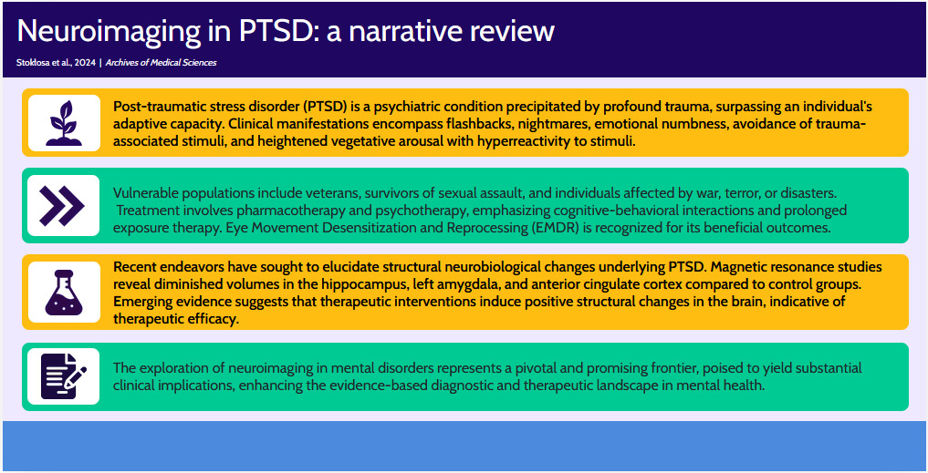

Neuroimaging in post-traumatic stress disorder: a narrative review
DOI: 10.5114/aoms/188377
Arch Med Sci 2025;21(1):32-41
Notes:
Post-traumatic stress disorder (PTSD) is a psychiatric pathology arising from severe trauma exceeding an individual’s adaptive capabilities. Clinical presentations include flashbacks, nightmares, emotional detachment, avoidance of trauma-related stimuli, and heightened vegetative arousal. High-risk groups encompass veterans, survivors of sexual assault, and those impacted by warfare, terrorism or calamities. Therapeutic approaches involve pharmacological and psychological interventions, particularly cognitive-behavioral modalities and prolonged exposure therapy. Eye movement desensitization and reprocessing (EMDR) is acknowledged for its therapeutic benefits. Recent investigations aim to delineate structural neurobiological alterations underpinning PTSD symptoms. Magnetic resonance imaging studies show reduced volumes in the hippocampus, left amygdala, and anterior cingulate cortex relative to control cohorts. Emerging data suggest that therapeutic interventions elicit favorable structural modifications in the brain, indicative of therapeutic efficacy. Neuroimaging exploration in mental disorders is a pivotal and promising frontier, poised to deliver significant clinical benefits, augmenting the evidence-based diagnostic and therapeutic domain in mental healthcare.

