Slide 1
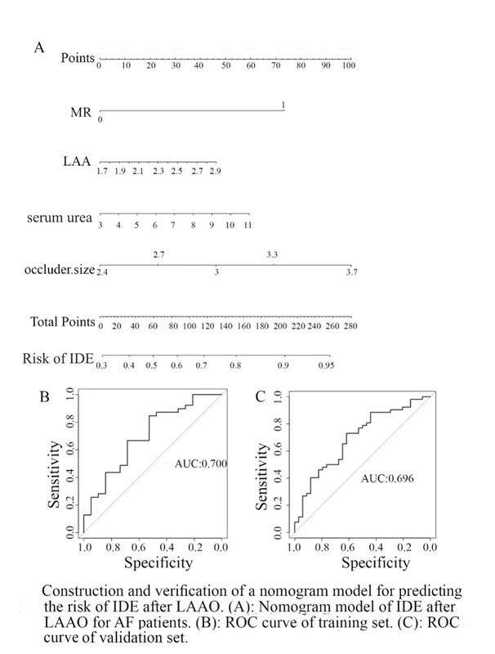

Risk factors of incomplete endothelialization after left atrial appendage occlusion in patients with atrial fibrillation
DOI: 10.5114/aoms/188529
Arch Med Sci 2025;21(1):75-83
Notes:
Introduction
We aimed to investigate the risk factors of incomplete device endothelialization (IDE) following left atrial appendage occlusion (LAAO) and provide a nomogram model for predicting the risks of IDE in patients with atrial fibrillation (AF).
Material and methods
A total of 145 patients with AF who underwent LAAO were included. The endothelialization of the occluder was assessed by computed tomography angiography (CTA) at 3 months after LAAO. Logistic regression analysis was used to explore the risk factors of IDE after LAAO. A nomogram model was constructed to predict the risks of IDE.
Results
53 cases with complete endothelialization (CDE group) and 92 cases with IDE (IDE group) were detected at 3 months after LAAO. There was a significant difference in mitral regurgitation (MR) (37.7% vs. 55.4%, p = 0.040), left atrial appendage (LAA) diameter ((2.22 ±0.36) cm vs. (2.61± 2.11) cm, p = 0.003), occluder size ((2.76 ±0.36) cm vs. (2.93 ±0.34) cm, p = 0.005) and the level of serum urea ((5.78 ±1.72) mmol/l vs. (6.67 ±2.82) mmol/l, p = 0.020) between the two groups. Serum urea level, MR, LAA diameter and large occluder size were independent risk factors for IDE (p = 0.038, 0.041, 0.007 and 0.006, respectively). A nomogram prediction model based on MR, LAA diameter, occluder size and serum urea was constructed with a C-index of 0.70, while the C-index of veriﬁcation was 0.708.
Conclusions
MR, higher serum urea level, LAA diameter and large occluder size may contribute to IDE after LAAO. The nomogram model based on MR, LAA diameter, occluder size and serum urea can be used to predict the IDE after LAAO.

