Slide 1
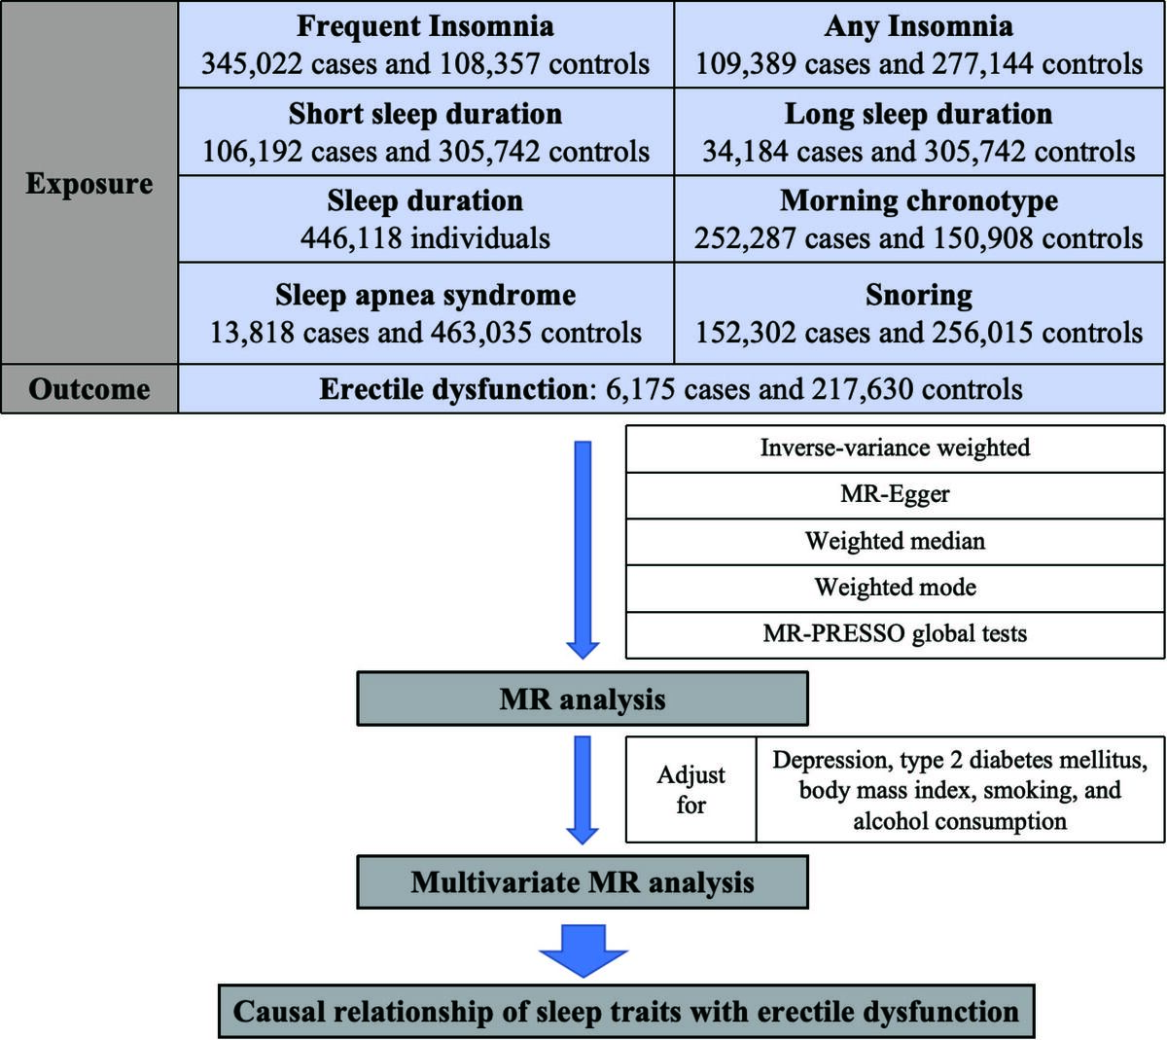

Causal relationship between sleep traits and erectile dysfunction: evidence from Mendelian randomization analysis
DOI: 10.5114/aoms/188718
Arch Med Sci 2025;21(2):597-604
Notes:
Introduction
Although several observational studies have explored the association between sleep traits and the risk of erectile dysfunction (ED), it remains controversial. In the present study, we included a wide range of sleep traits that are commonly observed in clinical practice. We investigated the causal relationship between these sleep traits and ED using univariate and multivariate Mendelian randomization (MR) methods.
Material and methods
Instrumental variables (IVs) for eight sleep traits (insomnia, sleep duration, chronotype, and sleep apnea syndrome), five confounders (depression, body mass index, smoking initiation, alcohol consumption, and type 2 diabetes), and ED were derived from genome-wide association study (GWAS) data of individuals of European ancestry. The primary analysis technique used was the inverse-variance weighted (IVW) approach. Furthermore, several sensitivity analyses were conducted to evaluate heterogeneity, horizontal pleiotropy, and stability.
Results
MR analysis revealed that increased snoring, short sleep, and frequent insomnia were associated with a higher risk of ED. Furthermore, we found evidence of a significant association between being a morning person and the risk of developing ED. This association persisted in multivariable MR analyses after adjusting for potential confounding factors. Sensitivity analysis suggested that the results were robust with no evidence of pleiotropy or heterogeneity.
Conclusions
This study provides further evidence supporting the association between genetically predicted snoring, insomnia, and an increased risk of ED. Additionally, the study highlights the causal relationship of short sleep duration and chronotype with ED.

