Slide 1
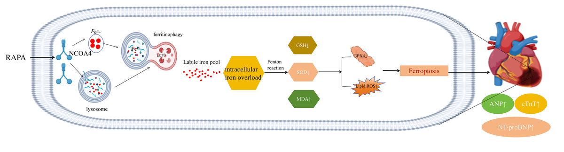

Excessive autophagy of myocardial cells promotes ferroptosis and exacerbates heart failure in the state
of myocardial infarction
DOI: 10.5114/aoms/188719
Arch Med Sci 2025;21(3):944-963
Notes:
Introduction
This study investigates the molecular mechanisms by which excessive autophagy exacerbates post-myocardial infarction heart failure (post-MI HF) through nuclear receptor coactivator 4 (NCOA4)-mediated ferritinophagy and ferroptosis.
Material and methods
We developed a post-MI heart failure model in Sprague-Dawley rats via coronary artery ligation, alongside an in vitro heart failure model using hypoxia/reoxygenation-stimulated H9C2 cells. Intervention with rapamycin (autophagy activator), 3-methyladenine (autophagy inhibitor), desferrioxamine, and ferredoxin-1 (ferroptosis inhibitors) was performed. Various techniques, including echocardiography, immunofluorescence colocalization, C11 BODIPY 581/591 staining, flow cytometry, transmission electron microscopy, western blotting, and RT-qPCR, were employed.
Results
In vivo analyses revealed that NCOA4-mediated ferritinophagy and ferroptosis are significant in post-MI HF. Manipulating autophagy through rapamycin and 3-methyladenine influenced the expression of NCOA4 and glutathione peroxidase 4 (GPX4), subsequently affecting ferroptosis and modulating heart failure severity. Our in vitro experiments corroborated these findings, demonstrating that heightened autophagy amplifies NCOA4 expression, which in turn fosters ferroptosis and exacerbates myocardial injury. Interestingly, silencing of NCOA4 partially mitigated autophagy-induced iron deficiency, indicating a crucial intersection between autophagy and iron metabolism. Moreover, the cardioprotective effects observed following NCOA4 silencing were negated by concurrent GPX4 silencing.
Conclusions
Our findings show that autophagy precedes NCOA4 in its regulatory pathway and directly influences ferritinophagy. Enhanced autophagy augments intracellular free iron and unstable iron pools, triggering lipid peroxidation through ferritinophagy, which promotes ferroptosis and impairs cardiac function. These insights offer a novel scientific basis for developing therapeutic strategies for post-MI HF.

