Slide 1
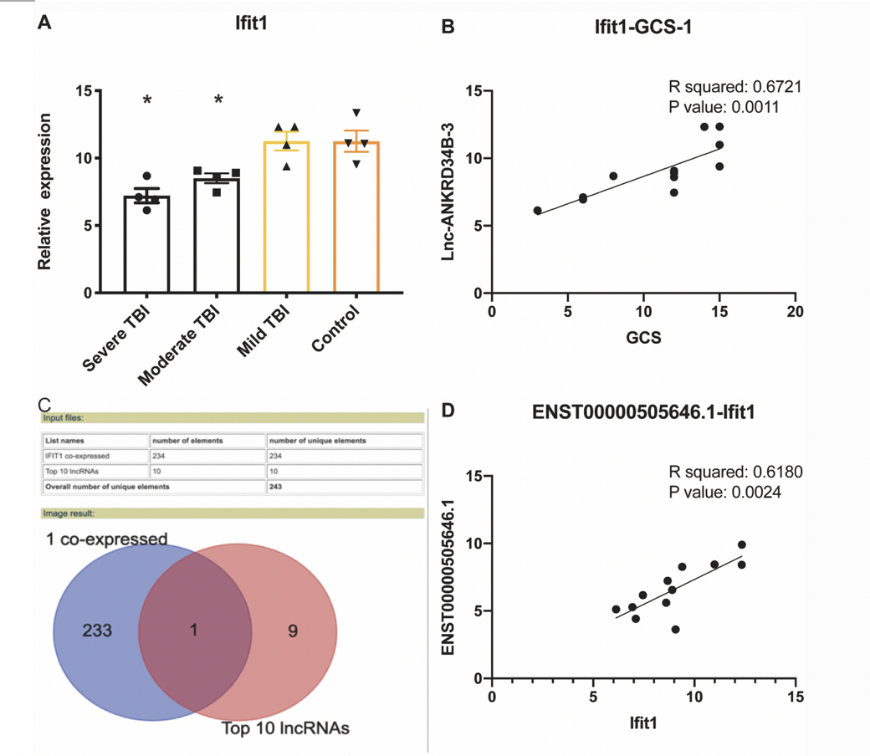

Long noncoding RNA RP11-704M14.1 acts as a sponge of miR-6756-5p to promote neuronal proliferation by regulating ALOX15 expression
DOI: 10.5114/aoms/188720
Notes:
Introduction
Long noncoding RNAs (lncRNAs) mediate critical effects in central nervous system diseases; however, the exact role of lncRNAs in human traumatic brain injury (TBI) remains elusive. Considering the principles of primary prediction, targeted prevention, and personalized treatment medicine (PPPM), identifying specific novel biomarker associated with TBI and exploring the underlying mechanisms comprehensively are crucial steps towards achieving primary prediction, targeted prevention, and personalized treatment of TBI.
Material and methods
In this study, we integrated single-cell RNA sequencing (sc-RNA-seq) data and microarray chipset data for TBI to identify a competing endogenous RNA axis.
Results
We detected 11 clusters based on the sc-RNA-seq data and identified Ifit1 as a marker gene co-expressed with ENST00000505646.1 (RP11-704M14.1). Additionally, the expression of IFIT1 and RP11-704M14.1 was found to decrease with the severity of TBI. RP11-704M14.1 promoted neuronal proliferation, and its knockdown prevented this effect. Furthermore, we found that RP11-704M14.1 functions as a miR-6756-5p sponge and increases the expression of its target gene ALOX15.
Conclusions
Our results show that RP11-704M14.1 promotes neuronal proliferation by sponging miR-6756-5p and regulating ALOX15 expression in brain insults; accordingly, targeting this lncRNA presents a promising avenue for advancing the transition from reactive medicine to PPPM in managing traumatic brain injury, potentially leading to significant clinical benefits.

