Slide 1
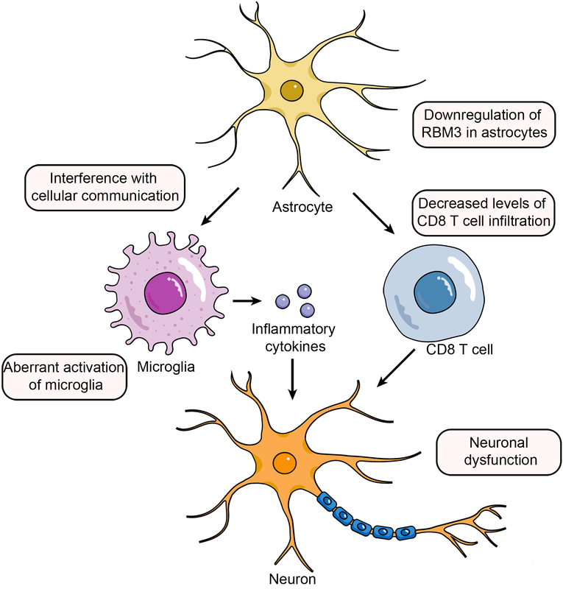

Identification of Alzheimer’s disease biomarkers and their immune function characterization
DOI: 10.5114/aoms/188721
Arch Med Sci 2025;21(1):233-257
Notes:
Introduction
Alzheimer's disease (AD) is a neurodegenerative disease with neurogenic fiber tangles caused by amyloid-β protein plaques and tau protein hyperphosphorylation as the pathological manifestations. This study was based on multi-omics to investigate the mechanisms and immune characterization of AD.
Material and methods
Based on bulk RNA-seq (GSE122063 and GSE97760), we screened potential biomarkers for AD by differential expression analysis and machine learning algorithms. Then, we elaborated the expression characteristics and immune functions of the above biomarkers by scRNA-seq (single-cell RNA sequencing) data analysis (GSM4996463 and GSM4996462) and immune infiltration analysis.
Results
Five biomarkers (RBM3, GOLGA8A, ALS2, FSD2, and LOC100287628) were identified using machine learning algorithms. Single-cell analysis revealed distinct expression patterns of these biomarkers in astrocytes from AD samples compared to normal samples. Additionally, three key biomarkers were selected based on interaction networks, and the diagnostic models indicated high diagnostic efficacy for these biomarkers. Based on immune infiltration and correlation analyses, RBM3, GOLGA8A, and ALS2 were all highly correlated with CD8 T cell content in the immune microenvironment of AD.
Conclusions
The biomarkers identified in this study demonstrate significant diagnostic potential for AD. Notably, the downregulation of RBM3 in astrocytes and the decreased presence of CD8 T cells infiltrating brain tissue are potential risk factors for AD.

