Slide 1
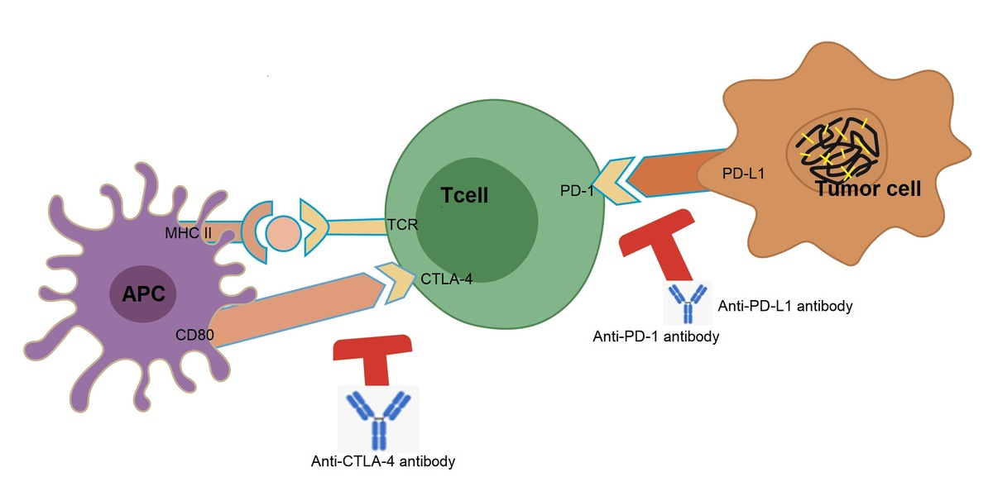

Recent advances in immune checkpoint inhibitor-based therapy of advanced hepatocellular carcinoma
DOI: 10.5114/aoms/188722
Notes:
Hepatocellular carcinoma (HCC) is the most common primary malignancy of the liver and is associated with a high mortality rate. Its occult origin often results in the loss of the optimal timeframe for liver transplantation and resection. During the past few decades, tremendous advances in the treatment of HCC have been achieved, and immunotherapy has become an attractive approach with promising results in clinical trials. In the present work, we review immune checkpoint inhibitors (ICIs) for their function and role in treating cancers, particularly advanced HCC, summarize recent therapeutic progress with various ICIs or their combinations with other options/therapeutic agents, and discuss works related to the development of biomarkers that predict therapeutic response as well as the limitations of ICIs. Future directions for immune checkpoint (ICP) therapy are also addressed.

