Slide 1
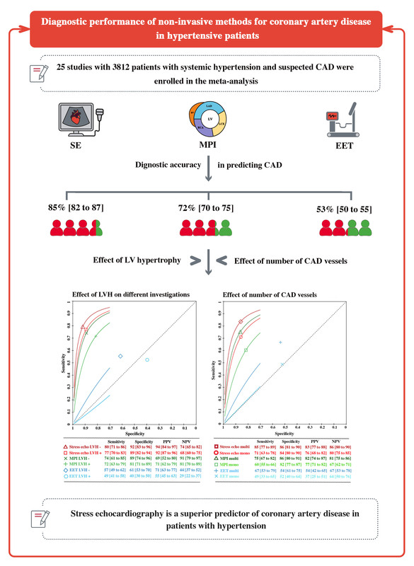

Diagnostic accuracy of non-invasive investigations for coronary artery disease in hypertensive patients: a meta-analysis
DOI: 10.5114/aoms/188782
Arch Med Sci 2025;21(1):167-178
Notes:
Introduction
Non-invasive assessment of coronary artery disease (CAD) in patients with hypertensive heart disease is still a major clinical challenge. The aim of this meta-analysis was to evaluate the diagnostic accuracy of different non-invasive techniques in detecting significant (> 50%) CAD in hypertensive patients.
Material and methods
We systematically searched selected electronic databases from inception until February 27th 2024. The main clinical endpoint was the diagnostic accuracy of non-invasive investigations including exercise electrocardiography test (EET), stress echocardiography (SE) and myocardial perfusion imaging (MPI). Random effects summary receiver operating characteristic analysis was performed.
Results
Twenty-five papers with a total of 3812 patients with systemic hypertension and suspected or known significant CAD were finally included in the meta-analysis. The diagnostic accuracy of SE was the highest compared to the two other investigations (85%, 72%, 53%, p < 0.05 for all). SE had higher sensitivity 85% (83–87%) and specificity 81% (79–83%) compared to MPI (sensitivity 81% (77–83%), specificity 64% (59–68%)) and EET (sensitivity: 53% (50–65%) and specificity 51% (47–54%)). All three tested investigations had higher accuracy in patients with multivessel disease compared to those with single-vessel disease (p < 0.05 for all). The diagnostic accuracy of SE and MPI was not significantly impacted by left ventricular hypertrophy (p > 0.05 for both) compared to EET, which was lower in patients with hypertrophy compared to those without (41% vs. 58%, p = 0.03). These results were consistent irrespective of the stress echo modality, physical, exercise or pharmacological (p > 0.05).
Conclusions
This meta-analysis reveals the powerful diagnostic value of stress echocardiography in detecting significant coronary artery disease in hypertension patients.

