Slide 1
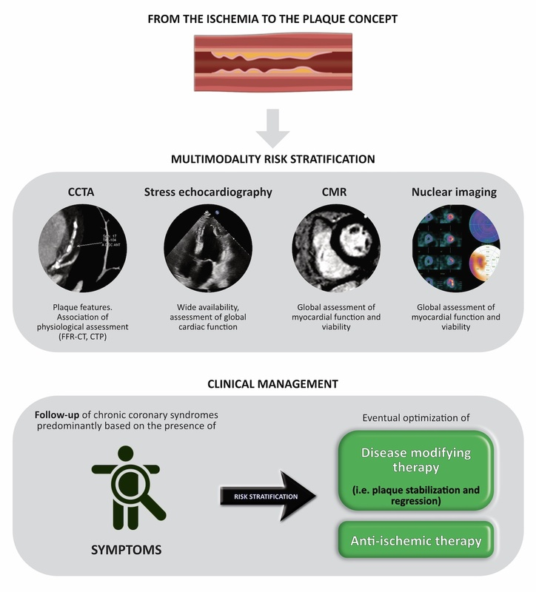

Imaging approaches in risk stratification of patients with coronary artery disease: a narrative review
DOI: 10.5114/aoms/188808
Arch Med Sci 2025;21(1):16-31
Notes:
Coronary artery disease (CAD) is the most common cause of mortality among adults worldwide. In the prognostic risk stratification of these patients, crucial determinants are lumen stenosis, total volume and composition of the plaque. Considering that most of the myocardial infarctions are due to non-obstructive plaques or are associated with high-risk features, plaque composition can serve as an independent predictor of cardiac outcomes. Conversely, although there is a close relationship between ischemia and CAD severity, the assessment of the degree of ischemia, as a surrogate marker of the coronary plaque burden, remains a controversial issue. Thus, aim of this narrative review is to discuss the usefulness of the imaging methodologies to differentiate the ischemia vs the plaque burden in clinical practice. New diagnostic tools to evaluate the extent of the atheromatous coronary artery could help in tailoring a personalized therapeutic approach.

