Slide 1
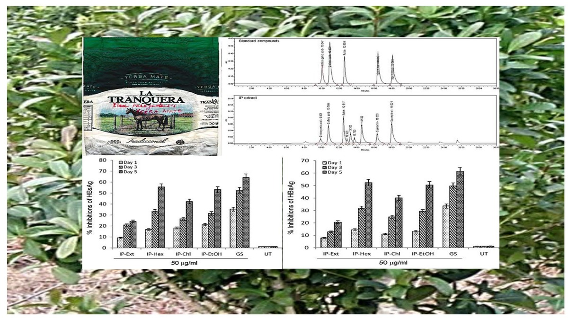

Antiviral flavonoids- and polyphenols-driven novel anti-HBV efficacy of<i> Ilex paraguariensis</i>
DOI: 10.5114/aoms/188809
Arch Med Sci 2025;21(3):919-929
Notes:
Introduction
Antiviral natural products have shown great promise as alternatives to conventional therapies to address drug resistance in hepatitis B virus (HBV). The abundance of bioactive flavonoids and polyphenolic contents in leaves of Ilex paraguariensis (yerba mate) warrants assessment of its anti-HBV activity.
Material and methods
The total ethanol extract of I. paraguariensis leaves (IP-Ext), including its n-hexane (IP-Hex), chloroform (IP-Chl), ethyl acetate (IP-EtAc) and ethanol (IP-EtOH) fractions, was tested for non-hepatocytotoxicity on HepG2 cells (MTT assay) and anti-HBV efficacy on HepG2.2.15 cells (ELISA). Further, quantitative high-performance liquid chromatography (HPLC) was employed to identify the antiviral compounds in the extract. In addition, in silico molecular docking was performed to delineate the possible mechanism of anti-HBV activity of the identified compounds.
Results
All samples showed non-cytotoxicity except IP-EtAc, with mild toxicity at 200 g/ml. Their anti-HBV assessment showed dose-dependent inhibitions of HBV antigens (HBsAg and HBeAg). At the selected optimal dose (50 g/ml), while IP-Ext showed mild (HBsAg: 24.2% and HBeAg: 20.6%) and IP-Chl showed moderate (HBsAg: 42.3% and 40.1%) activity, IP-Hex (HBsAg: 55.6% and HBeAg: 52.4%) and IP-EtOH (HBsAg: 53.2% and HBeAg: 50.2%) exhibited high activity. HPLC revealed known anti-HBV flavonoids (rutin: 18.98, quercetin: 6.52 and kaempferol: 9.10 g/g) and polyphenols (caffeic acid: 11.43 and chlorogenic acid: 3.22 g/g) in the extract. Their (10 g/ml, each) anti-HBV activities were: quercetin (HBsAg: 67.8% and HBeAg: 64.4%), kaempferol (HBsAg: 63.5% and HBeAg: 61.6%), chlorogenic acid (HBsAg: 55.2% and HBeAg: 53.8%), rutin (HBsAg: 51.2% and HBeAg: 48.4%) and caffeic acid (HBsAg: 42.2% and HBeAg: 39.5%). Notably, while our previous molecular docking had shown strong interactions of these flavonoids with HBV polymerase, here, we observed good binding affinity of the polyphenols with both drug-sensitive (wild-type) and drug-resistant (mutant) polymerases.
Conclusions
This is the first study suggesting the anti-HBV therapeutic efficacy of I. paraguariensis attributed to its antiviral flavonoids and polyphenols.

