Slide 1
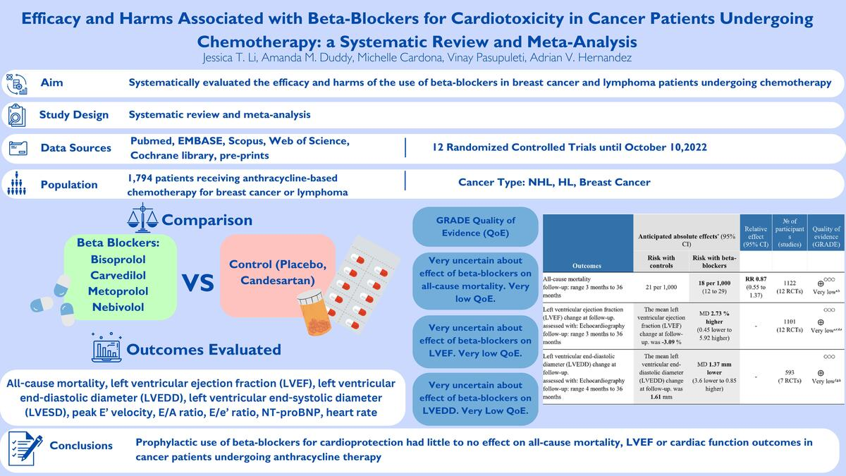

Efficacy and harms associated with β-blockers for cardiotoxicity in cancer patients undergoing chemotherapy: a systematic review and meta-analysis
DOI: 10.5114/aoms/189501
Arch Med Sci 2025;21(2):564-576
Notes:
Introduction
In patients with breast cancer and lymphoma, anthracyclines are associated with early and late dose-related cardiotoxicity. We systematically evaluated the efficacy and harms of the use of -blockers in breast cancer and lymphoma patients undergoing chemotherapy.
Material and methods
We searched five engines, and pre-prints until October 10, 2022, for randomized controlled trials (RCTs) evaluating β-blockers for anthracycline-associated cardiotoxicity in breast cancer and lymphoma patients. Primary outcomes were all-cause mortality, left ventricular ejection fraction (LVEF), left ventricular end-diastolic and end-systolic diameter (LVEDD, LVESD), peak E' velocity, E/A ratio, E/e' ratio, and NT-pro BNP levels. The secondary outcome was heart rate. Inverse variance random effect meta-analyses were performed, and we used GRADE methods to assess quality of evidence (QoE).
Results
Twelve RCTs were selected (<i>n</i> = 1,794). Seven RCTs evaluated carvedilol. Mean ages were 39 to 52 years; 88.5% were women; 79.4% had breast cancer, and 11.5% lymphoma. The evidence was very uncertain about the effect of β-blockers on all-cause mortality (RR = 0.87, 95% CI: 0.55 to 1.37, 12 RCTs, <i>I<sup>2</sup></i> = 0%, very low QoE), LVEF (MD = 2.73%, 95% CI: –0.45% to 5.92%, 12 RCTs, <i>I<sup>2</sup></i> = 93%, very low QoE), and heart rate (MD = –9.14 bpm, 95% CI: –15.02 to –3.26, two RCTs, <i>I<sup>2</sup></i> = 87%, very low QoE) vs. controls. β-blockers likely reduced NT-pro BNP levels slightly (MD = –15.35 pg/ml, 95% CI: –22.39 to –8.31, two RCTs, <i>I<sup>2</sup></i> = 0%, moderate QoE). There were no effects on other outcomes, all with very low QoE.
Conclusions
Prophylactic use of β-blockers for cardioprotection had little to no effect on all-cause mortality, LVEF or cardiac function outcomes in cancer patients undergoing anthracycline therapy.

