Slide 1
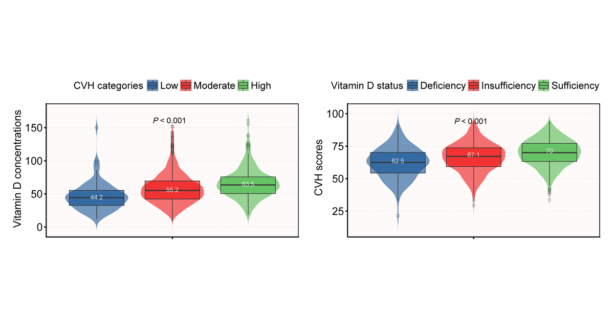

Association between serum vitamin D concentrations and Life’s Essential 8 score in American adolescents
DOI: 10.5114/aoms/189503
Arch Med Sci 2025;21(1):42-50
Notes:
Introduction
This study sought to use the latest Life’s Essential 8 scoring tool to obtain information on the relationship between serum vitamin D concentration and adolescent cardiovascular health (CVH).
Material and methods
A total of 1,819 teenagers aged 16–19 were enrolled. Associations between serum vitamin D concentrations and CVH ratings were estimated using multiple linear regression and multinomial logistic regression methods, and the dose-response relationship was examined by restricted cubic spline analysis.
Results
After adjusting for all confounding factors, serum vitamin D concentrations were positively correlated with CVH scores (β = 0.12; 95% CI: 0.09–0.14, p < 0.001). Among the sex and race subgroups, the correlation was stronger in male, Mexican American and Non-Hispanic Black participants, with odds ratios (ORs) of 1.05 (95% CI: 1.03–1.07), 1.06 (95% CI: 1.04–1.08), p = 0.002), 1.07 (95% CI: 1.03–1.11), 1.09 (95% CI: 1.05–1.14), p = 0.01, 1.04 (95% CI: 1.01–1.06), and 1.05 (95% CI: 1.02–1.09), p = 0.01, respectively. Serum vitamin D concentrations had a nonlinear relationship with CVH ratings. CVH scores grew with serum vitamin D concentrations up to the inflection point (86 nmol/l) (β = 0.17 (95% CI: 0.135–0.206, p < 0.001). When serum vitamin D concentrations exceeded 86 nmol/l, CVH scores were not associated with serum vitamin D concentrations.
Conclusions
The study identified a nonlinear relationship between serum vitamin D levels and CVH in US adolescents aged 16–19, with an inflection point at 86 nmol/l. These findings underscore the importance of vitamin D in adolescent CVH and suggest the need for targeted health strategies, particularly in high-risk groups such as male, Mexican American, and Non-Hispanic Black teenagers.

