Slide 1
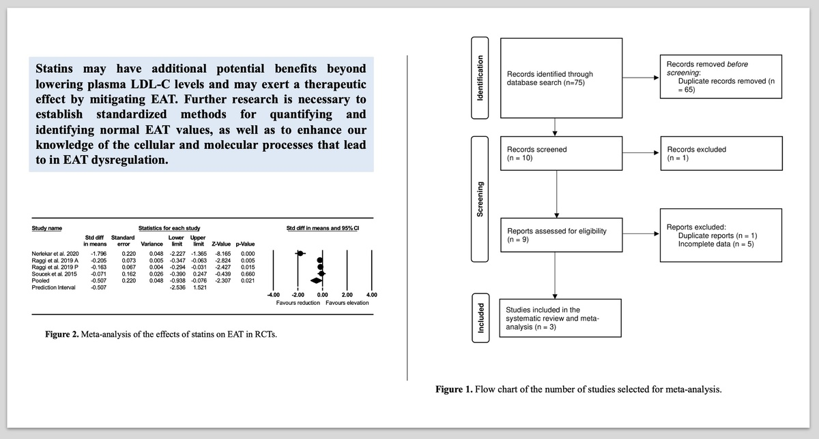

Efficacy of statin therapy in reducing epicardial adipose tissue: a systematic review and meta-analysis
DOI: 10.5114/aoms/189575
Arch Med Sci 2024;20(3):997-1001
Notes:
Introduction
Understanding the effect of statins on epicardial adipose tissue (EAT) is important as it may help reduce the negative impact of EAT-derived molecules on the cardiovascular system and consequently on coronary artery disease. Thus, we aimed to perform a systematic review and meta-analysis to assess the impact of statin therapy on EAT.
Methods
The study utilized Scopus, PubMed, Embase, and Web of Science to gather relevant studies on the impacts of statins on EAT until September 5th, 2023. The data collected underwent meta-analysis using Comprehensive Meta-Analysis (CMA) V4 software.
Results
In the meta-analysis, three studies involving 512 subjects were ultimately incorporated. The findings indicated a significant decrease in EAT after treatment with statins (standardized mean difference (SMD = –0.507, 95% CI: –2.536, 1.521, p = 0.021).
Conclusions
Statins appear to exert an additional cardiovascular therapeutic effect by reducing EAT.

