Slide 1
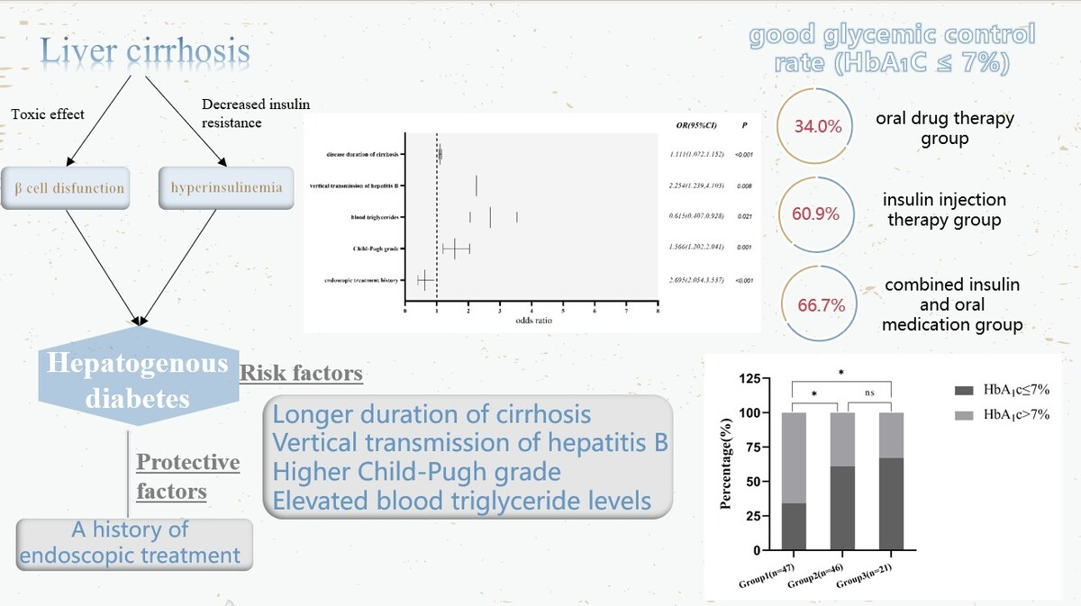

From cirrhosis to hepatogenous diabetes: risk factors and glycemic management
DOI: 10.5114/aoms/189834
Arch Med Sci 2025;21(2):383-391
Notes:
Introduction
Our study analyzed the risk factors associated with hepatogenous diabetes (HD) and compared glycemic control under various treatment modalities.
Material and methods
The multicenter study included 327 patients with HD, while 329 non-diabetic liver cirrhosis (LC) patients were selected as the control group for examining HD risk factors. Three groups of HD patients with HbA1c were distinguished based on their glucose-lowering treatment regimen to compare glycemic control.
Results
The results indicated that longer disease duration of cirrhosis (OR = 1.111, 95% CI: 1.072–1.152, <i>p</i> < 0.001), vertical transmission of hepatitis B (OR = 2.254, 95% CI: 1.239–4.103, <i>p</i> = 0.008), a high Child-Pugh grade (OR = 1.566, 95% CI: 1.202–2.041, <i>p</i> = 0.001) and higher blood triglyceride levels (OR = 2.695, 95% CI: 2.054–3.537, <i>p</i> < 0.001) were independent risk factors for HD. A history of endoscopic treatment (OR = 0.615, 95% CI: 0.407–0.928, <i>p</i> = 0.021) was a protective factor for HD. Insulin or insulin in combination with oral hypoglycemic agents is more effective compared to oral medication alone (<i>p</i>1 < 0.05, <i>p</i>2 < 0.05).
Conclusions
The risk factors for HD include prolonged duration of LC, vertical transmission of hepatitis B, higher Child-Pugh grade, and elevated blood triglyceride levels. A history of endoscopic treatment was found to be a protective factor. Glycemic management was substantially enhanced among patients who received insulin therapy, either alone or combined with oral hypoglycemic drugs, as opposed to those who depended solely on oral hypoglycemic agents.

