Slide 1
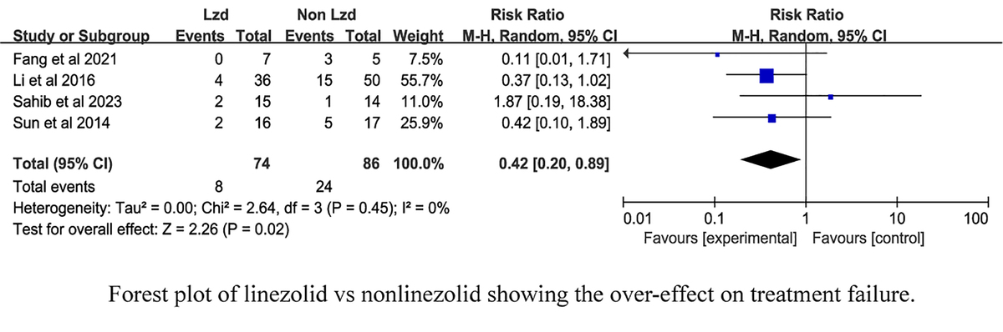

Efficacy of linezolid in the treatment of tuberculous meningitis: a meta-analysis
DOI: 10.5114/aoms/189905
Arch Med Sci 2024;20(3):1038-1042
Notes:
Introduction
Tuberculous meningitis (TBM) is a severe extra-pulmonary tuberculosis with high fatality. This meta-analysis aimed to assess the impact of linezolid on TBM treatment outcomes.
Methods
We searched multiple databases for studies published up to May 18, 2024 comparing the effects of linezolid on TBM. Meta-analysis was conducted using Review Manager 5.4.
Results
Our findings indicated that linezolid may reduce treatment failure risk (RR = 0.42 (0.20, 0.89), p = 0.02) and improve temperature recovery (RR = 1.56 (1.21, 2.02), p < 0.001) in TBM patients.
Conclusions
The analysis suggests a positive association between linezolid treatment and therapeutic improvements, with no significant adverse reactions reported.

