Slide 1
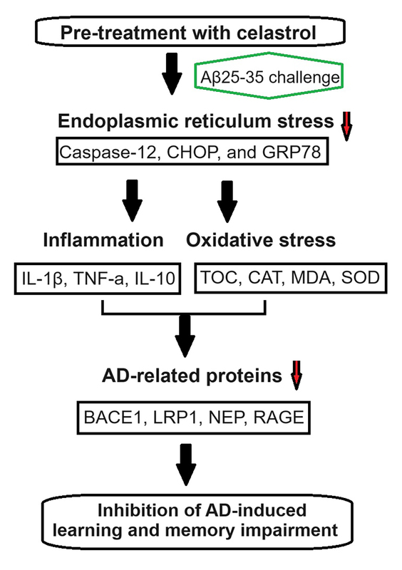

Celastrol attenuates Alzheimer’s disease-mediated learning and memory impairment by inhibiting endoplasmic reticulum stress-induced inflammation and oxidative stress
DOI: 10.5114/aoms/189906
Arch Med Sci 2025;21(2):538-554
Notes:
Introduction
Alzheimer’s disease (AD) is triggered by biological mechanisms such as neuroinflammation and oxidative stress. Endoplasmic reticulum (ER) stress can lead to the expression of molecular chaperones in the ER, which helps in restoring cellular homeostasis. Researchers have highlighted the role of ER stress in the progression of AD, suggesting that regulating it could be a potential treatment strategy for AD.
Material and methods
We induced AD in mice by injecting amyloid beta-peptide 25-35 (Aβ25-35) bilaterally into the CA1 of the dorsal hippocampus. Some mice were administered celastrol intraperitoneally before the Aβ25-35 injection, while others received it after the injection. The mice underwent the Barnes maze cognitive test and Morris water maze test to assess learning and memory impairment. Levels of interleukin (IL)-1β, tumor necrosis factor α, and IL-10 were measured to evaluate inflammation, while total antioxidant capacity, catalase, malondialdehyde, and superoxide dismutase levels were analyzed to estimate oxidative stress.
Results
Our study showed that pre-treatment with celastrol could prevent learning and memory decline in AD mice by reducing inflammation and oxidative stress. Celastrol also inhibited AD-induced inflammation and oxidative stress. Additionally, celastrol suppressed AD progression by targeting ER stress. These results suggest that celastrol treatment could be beneficial in addressing learning and memory deficits in AD, paving the way for potential neuroprotective treatments.
Conclusions
Celastrol effectively improved learning and memory impairments in AD mice by targeting ER stress-induced inflammation and oxidative stress. This highlights the potential of celastrol as a therapeutic agent for AD.

