Slide 1
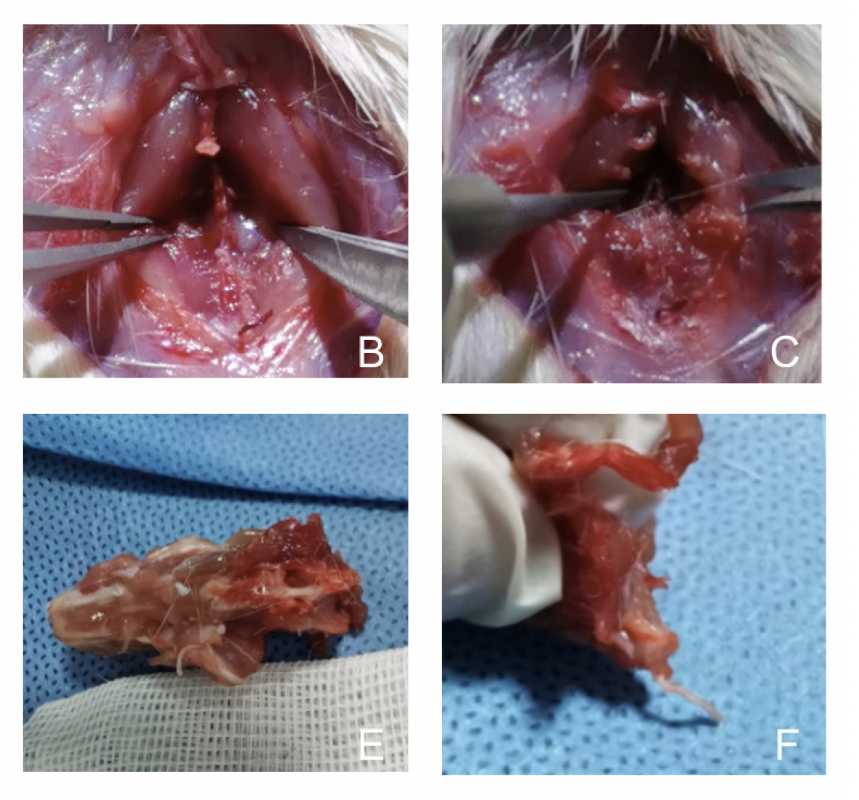

Effect of paeoniflorin on neuronal autophagy and Notch expression in tethered spinal cord in rats
DOI: 10.5114/aoms/189969
Arch Med Sci 2025;21(5):2125-2135
Notes:
Introduction
The study aimed to investigate the role of paeoniflorin in regulating neuronal autophagy and explore its ameliorative effects on the NOTCH signaling pathway in rat tethered spinal cord syndrome (TCS).
Material and methods
We conducted an experiment using 60 healthy male SD rats, randomly divided into six groups: Sham + Vehicle (saline) group; Sham + Paeoniflorin (PF) 25 mg/kg group; TCS + Vehicle group; TCS + PF 25 mg/kg group; TCS + PF 50 mg/kg group; TCS + PF 100 mg/kg group. We assessed neurological recovery by measuring Tarlov scores and Basso-Beattie-Bresnahan (BBB) scores at 1, 3, 7, 11, and 14 days after injecting PF. Additionally, we evaluated autophagic pathways, including LC3, Beclin1, and Notch protein expressions in rat spinal cord cells for each group.
Results
Lower limb neurological scores decreased after surgery on the first postoperative day. As the PF concentration increased, the recovery of Tarlov and BBB scores in rats accelerated. The comparison between PF treatment groups with different concentrations revealed a concentration-dependent effect. In the treated group, LC3 and Beclin1 protein expression levels gradually decreased with increasing PF dose. Notch protein expression around spinal cord tissue significantly increased in the treated group of rats, while it was not significant in the control group (Sham, Sham + PF 25 mg/kg groups).
Conclusions
The results demonstrate that paeoniflorin can inhibit neuronal autophagy-related proteins and suppress apoptosis in spinal cord tissue. This inhibition contributes to improving neurological function in rats with tethered cord syndrome through the combined actions of autophagy inhibition and Notch pathway activation.

