Slide 1
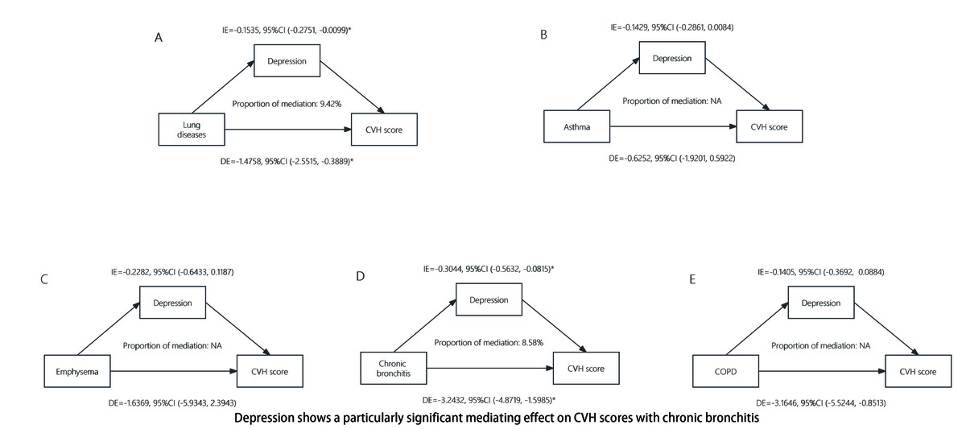

The mediating effect of depression on the association between lung disease and cardiovascular health
DOI: 10.5114/aoms/189973
Arch Med Sci 2024;20(3):1029-1033
Notes:
Introduction
In this study, we investigated the effect of depression on the interaction between lung disease and cardiovascular health (CVH).
Methods
Utilising data from the National Health and Nutrition Examination Survey (2013–2018), we employed multivariate regression and bootstrap mediation analysis to explore the relationships among lung diseases, depression, and CVH scores.
Results
Complex and significant associations were identified among lung diseases, depression, and CVH scores, with depression mediating 9.42% of the effect on CVH, especially for chronic bronchitis patients.
Conclusions
Depression significantly mediated the relationship between lung disease and reduced CVH scores, highlighting the importance of mental health management in lung disease patients.

