Slide 1
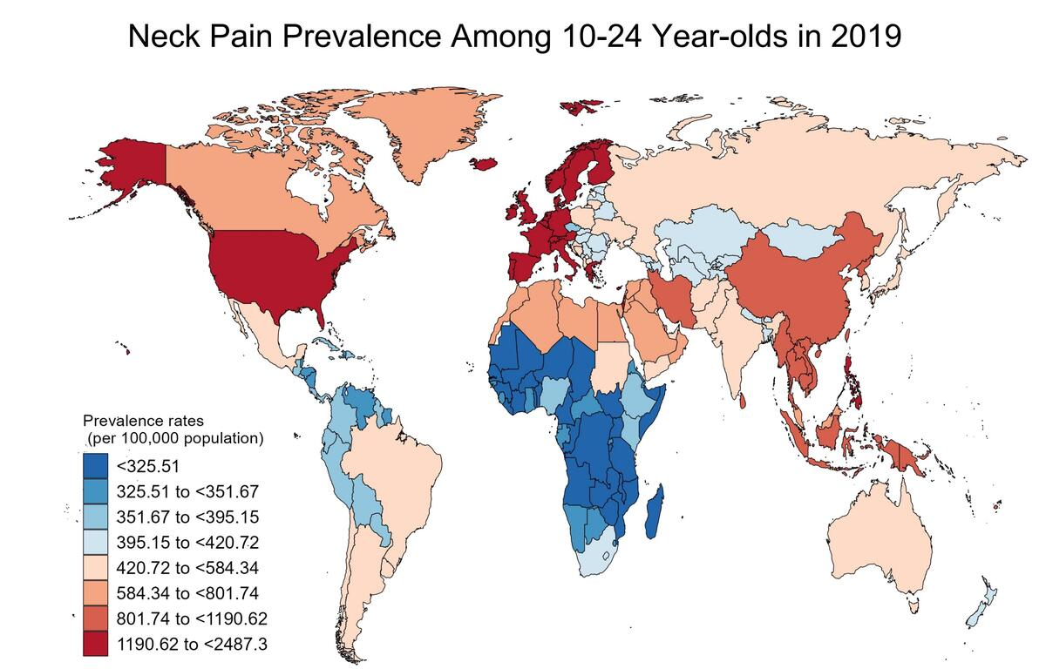

Temporal trends in neck pain prevalence among adolescents and young adults aged 10–24 from 1990 to 2019
DOI: 10.5114/aoms/190029
Arch Med Sci 2025;21(2):514-525
Notes:
Introduction
Neck pain is common among adolescents and young adults, affecting their health and well-being. However, research on its prevalence trends in this demographic is limited despite its global significance.
Material and methods
Data from the Global Burden of Disease Study were used to analyze neck pain prevalence and trends among individuals aged 10 to 24 from 1990 to 2019. Temporal trends and regional differences were assessed using estimated annual percentage changes.
Results
Globally, the number of adolescents and young adults affected by neck pain increased from 11,594,119 cases in 1990 to 12,880,134 in 2019. Despite this increase, the prevalence rate stabilized, dropping from 74,850.57 per 100,000 individuals in 1990 to 69,178.4 per 100,000 in 2019, with an annual decrease of –0.28%. In 2019, prevalence rates for ages 10–14, 15–19, and 20–24 were 31,624.66, 69,189.45, and 109,351.52 per 100,000 individuals, respectively. The regions with the highest prevalence rates in 2019 were Western Europe, high-income North America, and Southeast Asia, with rates of 1938.57, 1930.2, and 1021.37 per 100,000 individuals, respectively. Nationally, the United Kingdom, Denmark, and Finland had the highest rates: 2,487.30, 2,442.03, and 2,336.94 cases per 100,000 individuals, respectively. Notably, regions with higher Socio-Demographic Index (SDI) levels tended to have higher prevalence rates of neck pain among adolescents and young adults, with variation by region and age group.
Conclusions
The study emphasizes the ongoing burden of neck pain among adolescents and young adults worldwide, emphasizing the necessity for targeted interventions to enhance public health outcomes in this group.

