Slide 1
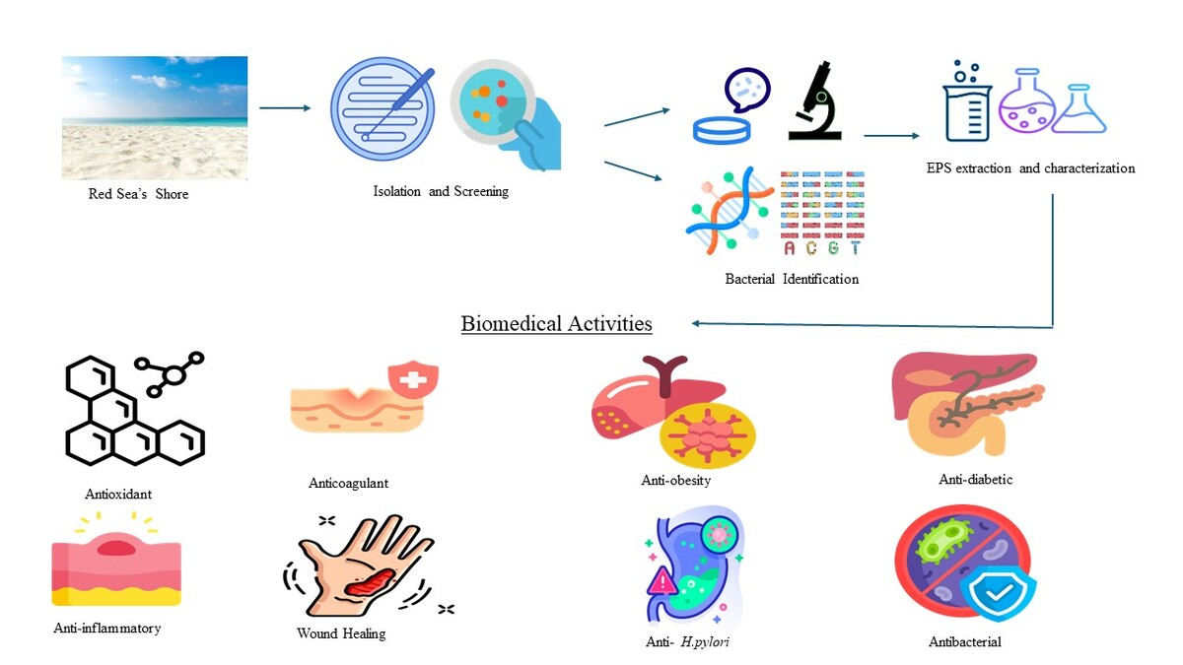

Investigating the multi-targeted pharmacological profile of an exopolysaccharide from <i>Bacillus rugosus</i> SYG20 via <i>in vitro</i> evaluation of its antioxidant, anti-inflammatory, antidiabetic, wound healing, and antimicrobial properties
DOI: 10.5114/aoms/190065
Arch Med Sci 2025;21(6):2389-2405
Notes:
Introduction
Exopolysaccharides (EPSs) derived from marine microorganisms are a newly recognized reservoir of bioactive therapeutic compounds.
Material and methods
We isolated a high EPS-yielding bacterial strain from the Red Sea, identified as Bacillus rugosus SYG20. Its purified EPS (EPSR9) contains 45.33% uronic acid, 9.98% sulfate groups, and 5.40% N-acetyl glucosamine. The HPLC chromatogram revealed four monosaccharides – glucose, xylose, galacturonic acid, and arabinose, in a distinct molar ratio of 2 : 3 : 1 : 1. EPSR9 showed a wide array of bioactivities.
Results
It displayed antioxidant activity with an IC50 of 25.6 µg/ml in the 2,2-diphenyl-1-picrylhydrazyl (DPPH) assay and a total antioxidant capacity (TAC) of 417.77 µg/ml ascorbic acid equivalent (AAE) and 62.67 µg/ml AAE in ferric reducing antioxidant power (FRAP) assays. It exhibited substantial anti-inflammatory properties by inhibiting 81.8–99% of hypotonic solution-induced hemolysis of human red blood cells (HRBCs) at 100–1000 µg/ml. The anticoagulant effect of the EPS was demonstrated by a dose-dependent increase in prothrombin time from 18.7 to 49.3 s and partial thromboplastin time from 33.5 to 60.3 s at 25–75 µg/ml. The scratch assay resulted in a 72.66% increase in wound closure, promoting in vitro wound healing after 48 h. Anti-obesity activity was evidenced by 83.8% lipase inhibition at 1000 µg/ml with IC50 of 107.73 µg/ml. EPSR9 demonstrated inhibitory effects on -amylase with an IC50 value of 14.37 µg/ml and -glucosidase with an IC50 value of 26.73 µg/ml, highlighting its potential as an antidiabetic agent. Then, EPS showed bactericidal properties with MBC/MIC ≤ 2 against both Gram-positive (G+ve) and Gram-negative (G-ve) bacteria, Staphylococcus aureus (MIC = 62.5 µg/ml), Enterococcus faecalis (MIC = 3.9 µg/ml), Salmonella typhi (MIC = 31.25 µg/ml), and Helicobacter pylori (MIC = 31.25 µg/ml). Additionally, it showed concentration-dependent anti-biofilm activity, achieving up to 88% for Salmonella typhi, 86.08% for Klebsiella pneumoniae, and remarkable antibiofilm activity at 95.60 % for H. pylori at 75% MBC.
Conclusions
The marine EPSR9 exhibited considerable potential for pharmaceutical applications as a multi-bioactive microbial metabolite. Its in vivo potency and mechanisms of action warrant further investigation.

