Slide 1
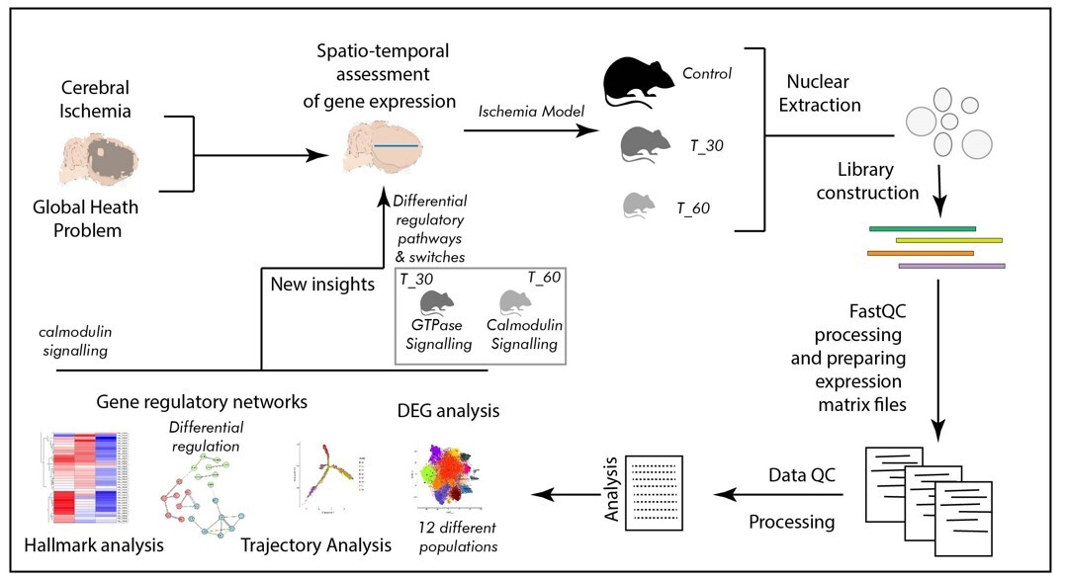

Single cell sequencing reveals heterogenicity of differential gene expression and altered interactome in post-ischemic mouse brain cells
DOI: 10.5114/aoms/190069
Notes:
Introduction
Ischemia, resulting from reduced blood supply, poses a critical health challenge. It is known to be caused by arterial constriction or blockages and triggers oxygen and nutrient deprivation, impacting multiple body systems and leading to a multitude of diseases and associated health conditions. Due to its multifaceted association with several diseases, ischemia is a subject of interest in many clinical studies. Over several decades of information on ischemia and related molecular changes have provided valuable insight into its pathophysiological outcomes. However, the scarcity of molecular studies, especially genomic inquiries employing spatial and temporal segregation, remains mostly unaddressed. The emerging field of single-cell genomics offers promising solutions to such inquiries. Therefore, we performed our study by utilizing a single-cell genomics approach, employing a mouse brain model of hypoxia at two distinct time points (30 min and 60 min of exposure with hypoxia) to delineate cellular trajectories, ontology, and the clustering of expression-based patterns in a cell-specific manner.
Material and methods
In the present study we developed a mouse model of hypoxia, which was established using the thread-plug method. The experimental groups were subjected to hypoxia for 30 min (T_30) and 60 min (T_60), while the sham surgery group was used as a control. Following excision of the cerebral cortex, nuclear isolation and library construction were performed before conducting spatio-temporal analysis of cortical cells. Comprehensive data analysis encompassed differential gene expression analysis, trajectory analysis, examination of gene regulatory networks, and hallmark analysis.
Results
The primary outcome of the single cell genomics analysis emerged as clustering of 12 distinct cell populations suggesting contrasting transcriptomic profiles. Furthermore, spatio-temporal distinction in cell signaling was identified as a switch from Ras GTPase signaling to calmodulin and calcium dependent signaling between two levels of ischemia. The most dynamic regions in terms of transcription were distal axons and growth cones in the T_30 group, and cell edges and the post-synaptic area in the T_60 group. Also, the synaptic vesicle cycle is likely to be involved in such transcription switching.
Conclusions
Our study employing a single-cell genomics approach provides valuable insights into the cellular dynamics during hypoxia exposure. The identified cell populations and associated molecular pathways offer potential targets for further research and development of targeted therapies in addressing the complex challenges posed by ischemia.

