Slide 1
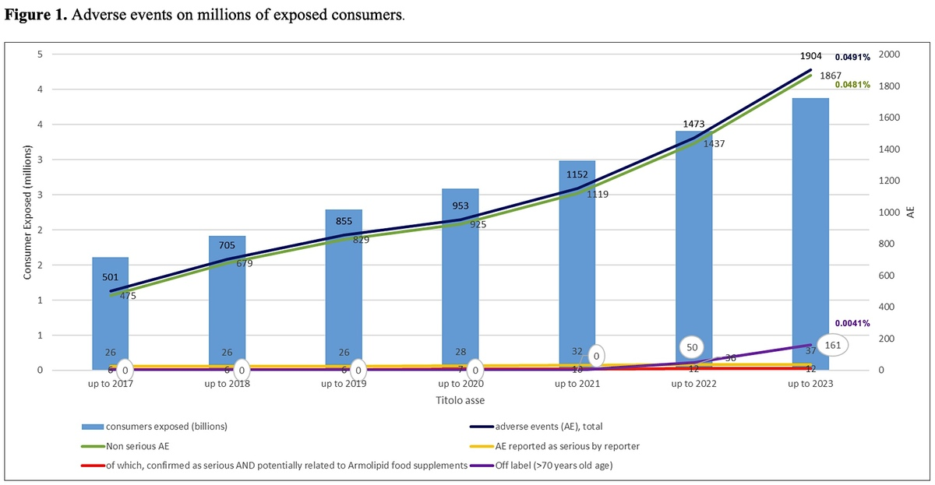

2024 update on postmarketing nutrivigilance safety profile: a line of dietary food supplements containing red yeast rice for dyslipidemia
DOI: 10.5114/aoms/190111
Arch Med Sci 2025;21(3):729-737
Notes:
Introduction
Considering lack of a European standardized postmarketing food supplement surveillance system (nutrivigilance), some member states and companies have developed their own approaches to monitoring potential adverse reactions (AEs) to secure a high level of product safety. This paper updates 2021 results of the use of a nutrivigilance system (which contained data to the end of 2019) in monitoring the incidence of spontaneously reported suspected AEs associated with red yeast rice (RYR) containing food supplements.
Material and methods
We report the data from a widely used product marketed under the trademark Armolipid/Armolipid Plus. Postmarketing information was collected in a voluntary nutrivigilance system established by the manufacturing company (Meda Pharma SpA, a Viatris Company, Monza, Italy). From 1st October 2004 to 31st December 2023, this system captured cases of suspected adverse reactions spontaneously reported by consumers, healthcare professionals, health authorities, regardless of causality.
Results
The total number of case reports received mentioning the RYR food supplement product line increased to 1186, in which 1904 adverse events (AEs) were reported. The total reporting rate of AEs was estimated to be 0.049% of 3,880,865 exposed consumers. Of the 1186 cases, 28 (0.0007% of exposed consumers) included suspected serious adverse events (SAEs). After very careful investigation, 9 cases (0.0002% of consumers exposed) and 12 AEs were assessed by the manufacturer as serious and potentially related to exposure to the above-mentioned RYR-based nutraceutical. Off-label reports linked to the newly introduced limitation at 70 years of age were observed, in contrast to the previous analysis.
Conclusions
This updated nutrivigilance-derived data analysis confirms a very low incidence of suspected AEs associated with the RYR product line. Consumer safety of food supplements could be generally improved by raising awareness of the importance of following the indications and warnings detailed in a food supplement’s labelling. Changes to the exposed population may impact the reporting rates.

