Slide 1
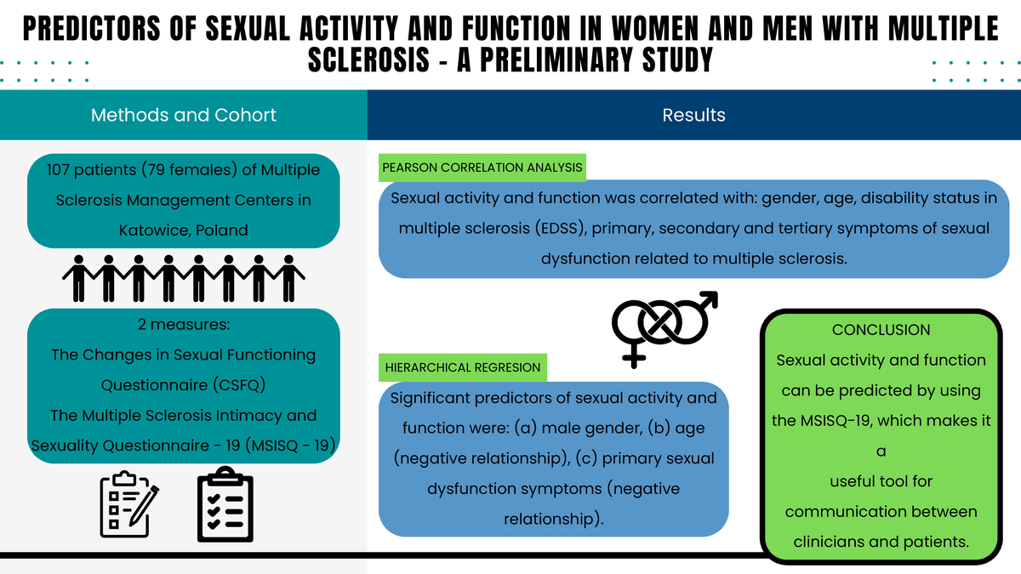

Predictors of sexual activity and function in women and men with multiple sclerosis – a preliminary study
DOI: 10.5114/aoms/190607
Arch Med Sci 2024;20(4):1321-1327
Notes:
Introduction
Sexual dysfunction (SD) is a common symptom of multiple sclerosis (MS) that is often underdiagnosed. The aim of the study was to determine predictors of sexual activity and function in patients with multiple sclerosis.
Material and Methods
A total of 134 MS patients were included in the study. Sexual activity and function were assessed by the Changes in Sexual Functioning Questionnaire (CSFQ). Symptoms of sexual dysfunction related to multiple sclerosis (the Multiple Sclerosis Intimacy and Sexuality Questionnaire-19; MSISQ-19), disability status in multiple sclerosis (the Expanded Disability Status Scale; EDSS), gender and age were also taken into account.
Results
As preliminary analyses for the regression model, Pearson correlation analysis was performed. This analysis indicated that all predictors (gender, age, EDSS score, and all three MSISQ-19 subscales) were significantly associated with the explained variable (sexual activity and function) in the expected direction. Finally, hierarchical regression showed that significant predictors of sexual activity and function were: (a) male gender, (b) age (negative relationship), and (c) primary sexual dysfunction symptoms (negative relationship).
Conclusions
Sexual activity and function can be predicted by using the MSISQ-19, which makes it a useful tool for communication between clinicians and patients.

