Slide 1
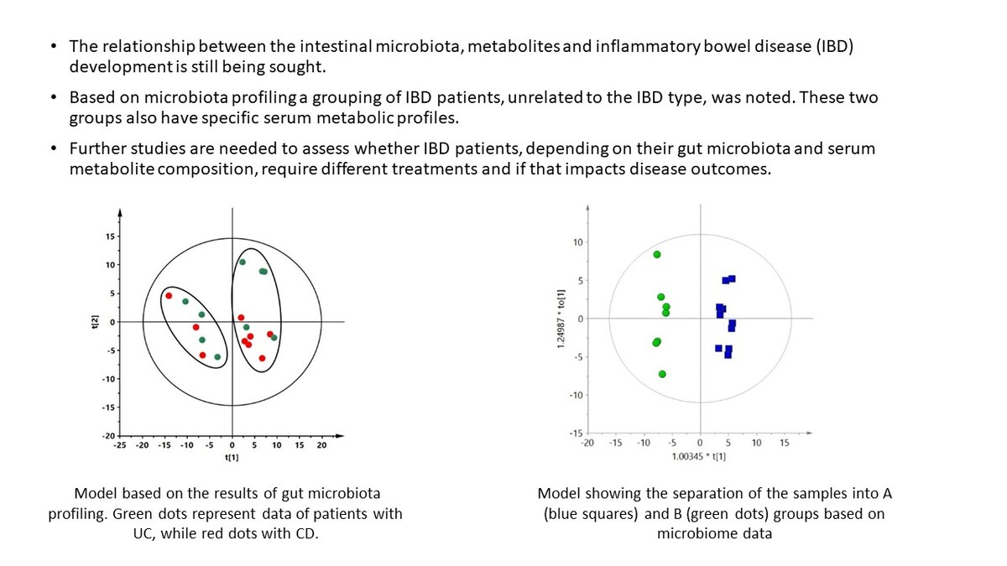

Evaluation of microbiome composition combined with serum untargeted metabolomic profiling in newly diagnosed children with inflammatory bowel disease
DOI: 10.5114/aoms/190623
Arch Med Sci 2025;21(2):416-424
Notes:
Introduction
The relationship between the intestinal microbiota, metabolites, and development of inflammatory bowel disease (IBD) is still being investigated. We aimed to assess whether the gut microbiome and serum metabolic profile are consistent with a diagnosis of Crohn’s disease (CD) or ulcerative colitis (UC) in children with newly diagnosed disease.
Material and methods
Bacterial abundance in fecal samples was evaluated using a 16S rRNA DNA-based test in treatment-naive children with IBD (<i>n</i> = 18) and healthy controls (<i>n</i> = 10). Metabolic fingerprinting of serum samples of the same individuals was estimated using liquid chromatography coupled with mass spectrometry.
Results
It was not possible to discriminate between CD and UC patients based on the gut microbiota profiles, but surprisingly, in the principal component analysis (PCA) model we observed a spontaneous separation of IBD patients into two groups, independently of IBD type. Then, serum metabolic profiles of these two microbiota-based groups of IBD patients were compared using orthogonal partial least squares discriminant analysis (OPLS-DA) modelling. Good quality models were obtained based on serum metabolomics data collected in positive and negative ion mode. In total, 12 metabolites significantly discriminating these groups were identified.
Conclusions
Based on microbiota profiling, a grouping of IBD patients, unrelated to the IBD type, was noted. These two groups also have specific serum metabolic profiles. Further studies are needed to assess whether IBD patients, depending on their gut microbiota and serum metabolite composition, require different treatments and whether that impacts disease outcomes.

