Slide 1
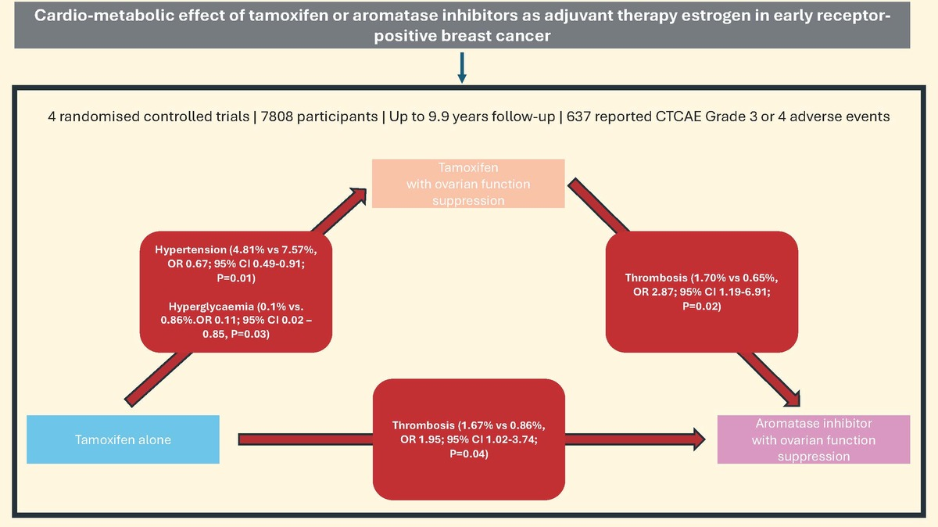

Cardiovascular and metabolic effects of ovarian suppression in combination with tamoxifen or an aromatase inhibitor as adjuvant therapy for early oestrogen receptor-positive breast cancer: a systematic review
DOI: 10.5114/aoms/190743
Arch Med Sci 2025;21(2):577-587
Notes:
Introduction
Adjuvant endocrine therapy is a key treatment in oestrogen receptor positive early breast cancer (BC). For premenopausal women, ovarian function suppression (OFS) in combination with either tamoxifen or aromatase inhibitor (AI) is utilised in high-risk cases. The resultant suppression of circulating oestradiol from OFS could have adverse cardiovascular and metabolic effects, subsequently increasing the risk of cardiovascular disease.
Material and Methods
A systematic search of online databases was conducted to identify randomised control trials involving OFS which reported cardiovascular and metabolic adverse events. Pooled odds ratios (ORs) with 95% confidence intervals (CIs) were estimated using a random-effects model.
Results
Four studies with a total of 7808 participants were included in the analysis. Tamoxifen alone carries a lower risk of hypertension compared with tamoxifen plus OFS (4.81% vs. 7.57%, OR = 0.67; 95% CI: 0.49–0.91; <i>p</i> = 0.01). The tamoxifen alone group showed a lower risk of hyperglycaemia compared to tamoxifen with OFS (0.10% vs. 0.86%, OR = 0.11; 95% CI: 0.02–0.85, <i>p</i> = 0.03).
Conclusions
Our study highlights the potential cardio-metabolic impact of endocrine therapy and OFS on premenopausal women with BC. It also highlights the pressing need for standardisation of routine collection and recording of cardiometabolic history and risk factors as part of baseline assessment and adverse event reporting to better understand the cardiometabolic impact these treatments have on our patients. Further studies, with particular focus on baseline and subsequent development of cardiovascular risk factors, are needed to explore the impact of these drugs on the cardiovascular health of young women with BC.

