Slide 1
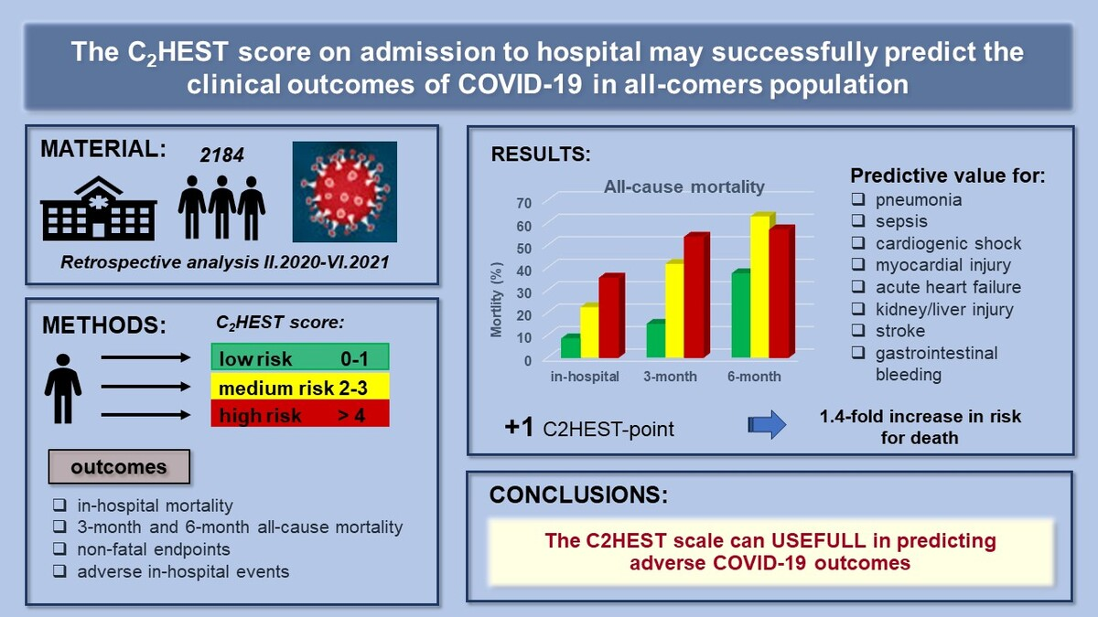

The C2HEST score on admission to hospital may successfully predict clinical outcomes of COVID-19 in the all-comers population
DOI: 10.5114/aoms/190744
Arch Med Sci 2025;21(3):817-827
Notes:
Introduction
During the SARS-CoV-2 pandemic, intensive efforts have been made to identify COVID-19 outcome predictors. The C2HEST score, used to predict the atrial fibrillation risk, reflects the presence of comorbidities. This study aimed to demonstrate the usefulness of this score in predicting COVID-19 outcomes in hospitalized individuals.
Material and methods
2184 medical records of subjects hospitalized due to COVID-19 between February 2020 and June 2021 were analyzed. Subjects were categorized into low/medium/high-risk categories according to the C2HEST score. Outcomes included: in-hospital-, 3- and 6-month-all-cause-mortality, non-fatal hospitalization endpoints, and other in-hospital events.
Results
598 deaths (27.4%), including 326 in-hospital (15%), were reported. All types of mortality were highest in the high-risk stratum (35.4%, 54.4%, 56.9%, respectively), and lowest in the low-risk stratum (8.4%, 15%, 37.5%, respectively). The ROC revealed that C2HEST allows one to predict 1-month mortality (AUC30 70.7) and remained at a similar level after 3- and 6-month observation (AUC90 = 72.0 and AUC180 = 67). The p-value for the log-rank test comparing survival curves was < 0.0001. An increase of one C2HEST point raised the overall death rate 1.4-fold. A change from the low- to medium-risk increased the death rate 3.4 times, while between the low- and high-risk-stratum the hazard ratio was 5.0. The C2HEST score also revealed predictive value for pneumonia, sepsis, cardiogenic shock, myocardial injury, acute heart failure, kidney/liver injury, stroke, and gastrointestinal bleeding.
Conclusions
The C2HEST score can predict COVID-19 outcomes in hospitalized subjects. This simple score, based on comorbidities, may address medical needs in the risk stratification of COVID 19 patients.

