Slide 1
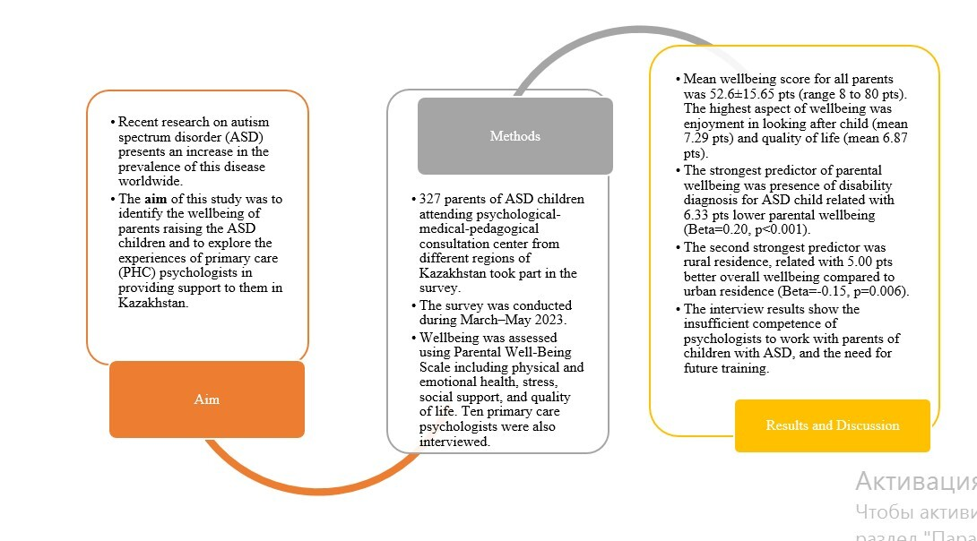

Wellbeing of parents raising children with autism spectrum disorder and the role of psychologists
DOI: 10.5114/aoms/190772
Arch Med Sci 2025;21(3):858-867
Notes:
Introduction
Recent research has shown a rise in the prevalence of autism spectrum disorder (ASD) worldwide. At the same time, care for ASD children was found to affect the psychological health of parents or guardians of ASD children. The aim of the study was to identify the wellbeing of parents raising ASD children and to explore the experiences of primary health care (PHC) psychologists in providing support to them.
Material and methods
We conducted a cross-sectional study. Parents of ASD children took part in the survey. Wellbeing was assessed using the Parental Well-Being Scale including physical and emotional health, stress, social support, and quality of life. Ten primary care psychologists were also interviewed.
Results
Three hundred and twenty-seven parents of ASD children participated in our study. The mean wellbeing score for all parents was 52.6 ±15.65 points. The highest scoring aspects of wellbeing were enjoyment in looking after the child (mean 7.29 points) and quality of life (mean 6.87 points). The strongest predictor of parental wellbeing was presence of a disability diagnosis for the ASD child (6.33 points), with lower parental wellbeing (β = 0.20, p < 0.001). The interview results show the insufficient competence of psychologists to work with parents of children with ASD.
Conclusions
On the Parental Well-Being Scale, the highest scores were observed for enjoyment in looking after the child and quality of life. Insufficient work is carried out by PHC psychologists with parents of children with ASD. There is a need for future training of psychologists in the management of children with ASD and their parents.

