Slide 1
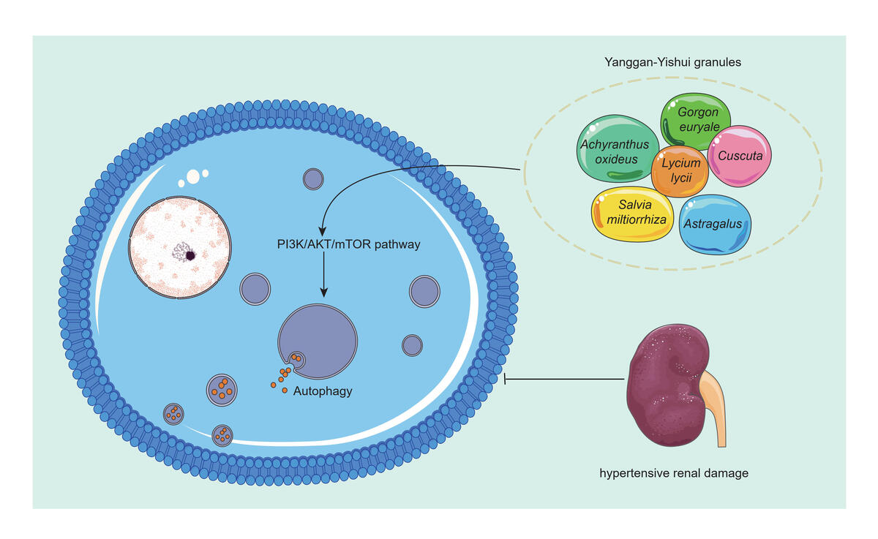

Network pharmacology and <i>in vitr</i>o experiments reveal the autophagy mechanism of Yanggan-Yishui granules in improving hypertensive renal injury
DOI: 10.5114/aoms/190794
Arch Med Sci 2026;22(1):387-407
Notes:
Introduction
In China, Yanggan-Yishui granules (YGYSG) have been used to treat hypertensive renal damage (HRD) for over 20 years. Network pharmacology was used to determine whether YGYSG affects HRD via the autophagy pathway, which was verified using in vitro experiments.
Material and methods
Common targets of YGYSG, HRD, and the autophagy pathway were screened using network pharmacology, and effective compounds, core targets, and signaling pathways were identified. The affinity of the compounds for the core targets was evaluated using molecular docking simulations. Angiotensin II (Ang II) was used to generate an in vitro renal podocyte model using MPC-5 cells. Morphological changes in the autophagosomes were observed using transmission electron microscopy (TEM). The expression levels of autophagy-related and pathway proteins were detected using western blotting and reverse transcription quantitative real-time polymerase chain reaction (PCR).
Results
Network pharmacology and molecular docking analyses identified eight autophagy-related core targets and ten core components in the YGYSG treatment of HRD. These targets are mainly involved in the phosphoinositide 3-kinase (PI3K)/protein kinase B (AKT)/mammalian target of rapamycin (mTOR) signaling pathway and autophagy-related biological processes. In vitro experiments showed that Ang II-stimulated renal podocytes exhibited abnormal autophagy, and YGYSG protected renal podocytes from abnormal autophagy. In addition, YGYSG reversed abnormal autophagy and improved HRD by activating the PI3K/AKT/mTOR signaling pathway.
Conclusions
YGYSG may regulate abnormal autophagy in renal podocytes by activating the PI3K/AKT/mTOR signaling pathway and may play a role in improving HRD.

