Slide 1
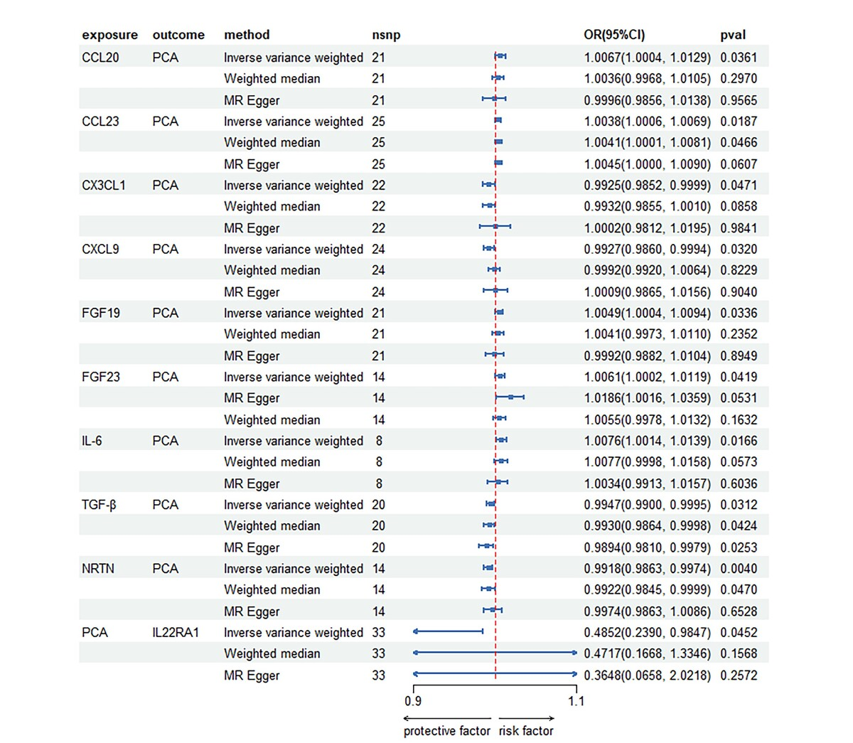

Association between inflammatory cytokines and prostate cancer: a bidirectional Mendelian randomization study
DOI: 10.5114/aoms/190828
Arch Med Sci 2025;21(5):2102-2112
Notes:
Introduction
We conducted a bidirectional two-sample Mendelian randomization (MR) analysis to investigate the causal relationship between 91 inflammatory cytokines and prostate cancer (PCa).
Material and methods
The inverse variance weighted (IVW) model served as the primary two-sample MR analysis method, utilized to estimate the causal effect of exposure on the outcome. The weighted median (WM) and MR Egger methods were additionally employed to complement the IVW model. Sensitivity analyses were performed using Cochran’s Q test for both the IVW and MR Egger methods. To assess the presence of horizontal pleiotropy, the instrumental variables (IVs) were subjected to the MR-Egger intercept test.
Results
Following Bonferroni correction, the IVW analysis revealed positive correlations between PCa and the levels of C-C motif chemokine 20 (CCL20), C-C motif chemokine 23 (CCL23), fibroblast growth factor 19 (FGF19), fibroblast growth factor 23 (FGF23), and interleukin-6 (IL-6). Notably, IL-6 exhibited the strongest positive association effect (odds ratio [95% confidence interval]: 1.0076 [1.0014, 1.0139]), followed by CCL-20 (1.0067 [1.0004, 1.0129]) and FGF23 (1.0002, 1.0119). Reverse MR analysis indicated a negative causal relationship between PCa and interleukin-22 receptor subunit alpha-1 levels (IL22RA1) (0.4852 [0.2390, 0.9847]).
Conclusions
This study suggested that there is a positive correlation between the levels of CCL20, CCL23, FGF19, FGF23, and IL-6 and the occurrence of PCa. Furthermore, we found evidence to support the causal relationship between decreased levels of IL22RA1 and the development of PCa. These findings reveal novel biomarkers and pathways that could potentially be targeted for the prevention and clinical treatment of PCa.

