Slide 1
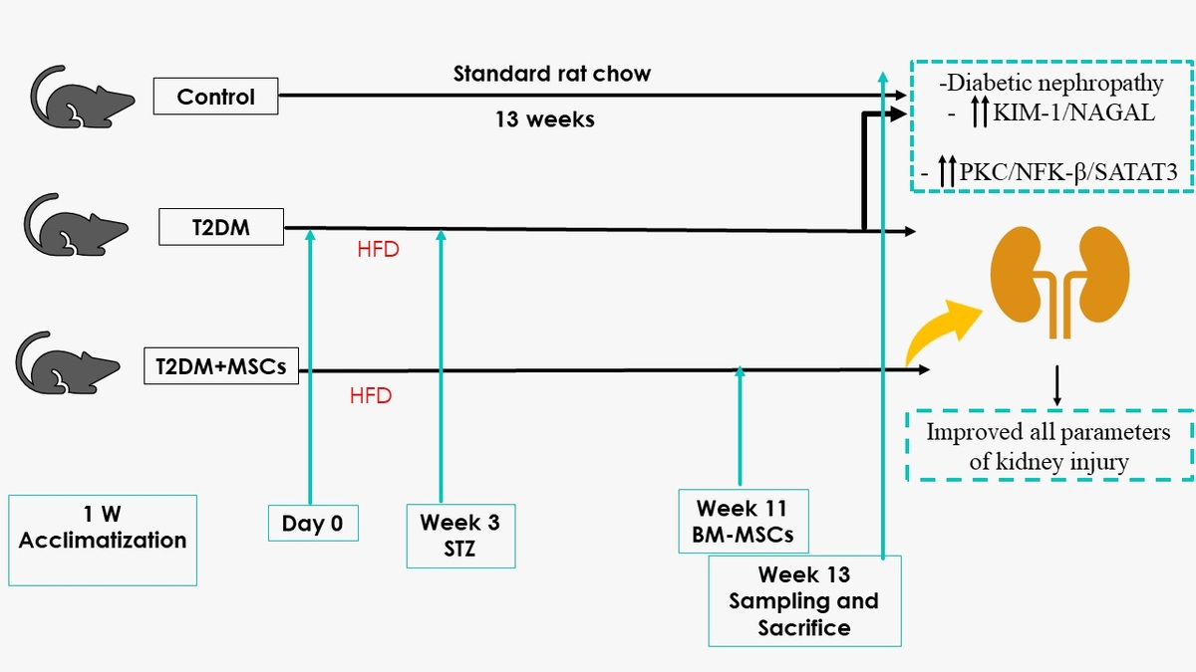

Mesenchymal stem cells suppress kidney injury molecule-1 associated with inhibition of renal PKC/NF-Kβ/STAT3 fibrotic signaling pathway in rats with diabetic nephropathy
DOI: 10.5114/aoms/190868
Arch Med Sci 2025;21(4):1577-1591
Notes:
Introduction
Diabetes is the predominant etiology behind end-stage kidney disease, commonly referred to as renal failure. The intricate relationships among oxidative stress, inflammation, and renal fibrotic changes in diabetes-induced nephropathy, particularly in instances involving and not involving the administration of mesenchymal stem cells (MSCs), remain a subject less explored in existing research.
Material and methods
Twenty-four male Wistar rats (180 and 200 g) were randomly assigned to one of three groups (n = 8). The control group received standard laboratory chow, and the groups with type 2 diabetes mellitus (T2DM) received a single dose of streptozotocin, 45 mg/kg, after 3 weeks of pretreatment with a high-fat diet (HFD). Rats with T2DM were split into the T2DM model group and bone marrow (BM) mesenchymal stem cells (MSC) treated group (T2DM + MSCs) 8 weeks after DM was confirmed. BM-MSCs were injected systemically at doses of 2 × 106 cells/rat.
Results
Diabetes significantly altered oxidative stress (MDA, SOD), inflammation (TNF-α, IL-6), and kidney injury (KIM-1, NAGAL) biomarkers, a modulation that was mitigated by MSCs (p < 0.0001). Furthermore, diabetes-induced kidney fibrosis showed a noteworthy reduction in the presence of MSCs. A notable correlation emerged between body weight, systolic blood pressure (SBP), oxidative stress, inflammation, fibrosis, the PKC/NF-KB/STAT-3 axis, and hyperglycemia.
Conclusions
Our results suggest that diabetes is associated with elevated oxidative stress, inflammation, biomarkers of kidney injury, upregulation of the renal PKC/NF-KB/STAT-3 pathway, and hypertension, all of which are countered by MSC intervention.

