Slide 1
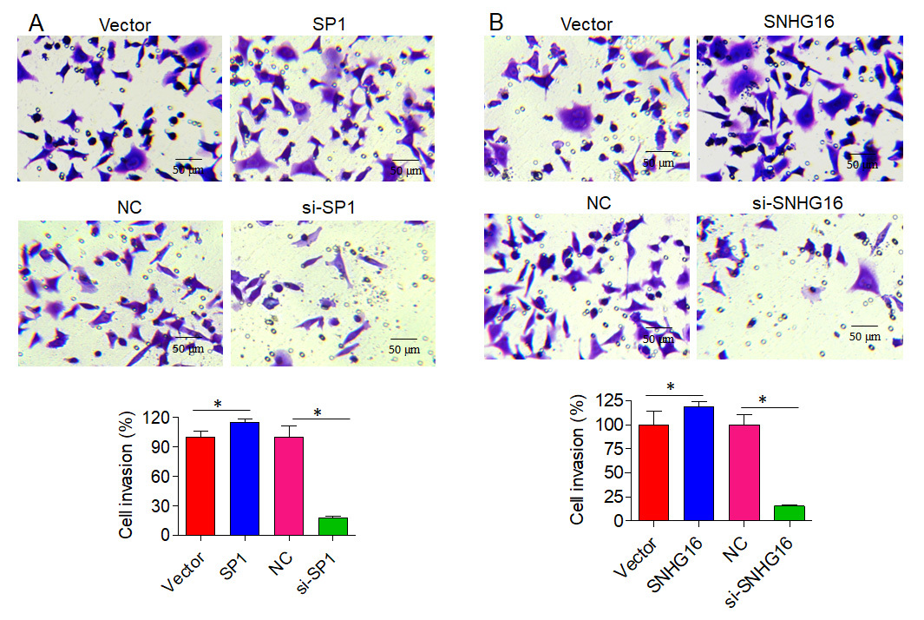

The SP1/SNHG16/GLUT1 axis promotes prostate cancer proliferation and invasion by regulating glucose metabolism
DOI: 10.5114/aoms/191153
Arch Med Sci 2025;21(2):638-647
Notes:
Introduction
The SP1/SNHG16/GLUT1 axis is involved in diverse cancer-related processes. This study was designed to study the role of the SP1/SNHG16/GLUT1 axis in prostate cancer (PCa) via modulation of glucose metabolism.
Material and methods
The expression profile of SNHG16 in PCa tissues was obtained from the online public database GEPIA (http://gepia.cancer-pku.cn/). Human prostate cancer cell lines, PC-3 and DU-145, were used in this study. Real-time qPCR was employed to determine the mRNA expression levels of SNHG16 and GLUT1. To assess cellular proliferation, CCK-8 assays were performed. Cellular invasion was evaluated using Transwell assays, and glycolysis was monitored through glucose uptake, lactate production, and ATP generation measurements.
Results
Analysis of GEPIA2 data revealed upregulation of SNHG16 in PCa tissues and a positive association between GLUT1 (SLC2A1) and SP1/SNHG16 expression in the correlation study. Consistently, SPI and SNHG16 were either overexpressed or knocked down in PCa cells to reveal the role of the SP1/SNHG16/GLUT1 axis. The results demonstrated that PC-3 and DU145 cell proliferation was promoted by the overexpression of either SPI or SNHG16. On the other hand, PC-3 and DU145 cell proliferation was reduced upon knockdown of SP1 or SNHG16. A real-time qPCR study revealed that GLUT1 mRNA was upregulated by SP1/SNHG16 overexpression and downregulated by SP1/SNHG16 knockdown. In PCa cells, overexpression of SNHG16/SP1 resulted in enhanced utilization of glucose, lactose, and ATP production, whereas SNHG16/SP1 knockdown had the reverse effect. Lastly, Transwell assay results showed that overexpression of SNHG16/SP1 promoted, while knockdown of SNHG16/SP1 inhibited, the invasiveness of PC-3 and DU145 PCa cells.
Conclusions
Collectively, the evidence indicates that the SP1/SNHG16/GLUT1 axis regulates proliferation of PCa cells via the glycolytic route and thus may act as a therapeutic target for PCa treatment.

