Slide 1
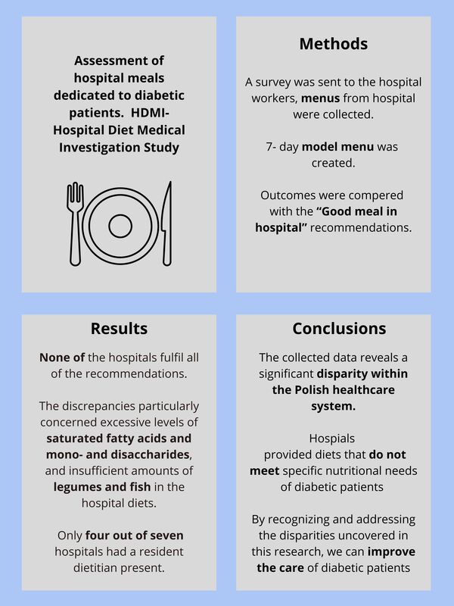

Assessment of special hospital meals for diabetic patients. Discrepancies between provided meals, model menus and dietary guidelines: a hospital diet medical investigation (HDMI) study
DOI: 10.5114/aoms/191298
Arch Med Sci 2025;21(5):1671-1682
Notes:
Introduction
In Poland, it is estimated that more than 2 million individuals have diabetes. Intervening in modifiable risk factors can effectively prevent and delay the onset of type 2 diabetes. Previous reports claimed that the Polish healthcare system did not guarantee proper nutrition and nutritional education. This study aimed to examine the dietary provisions for diabetic patients in Poland’s hospitals and evaluate their compliance with the Good Meal in Hospital (Dobry Posiłek w Szpitalu) guidelines.
Material and methods
Hospital workers were asked to complete the survey regarding hospital (degree of reference, number of beds in total and internal medicine unit, availability of a special diet for diabetic patients, performing nutritional education and presence of a dietitian) and attach menus from meals received by patients from 10 consecutive days. The menus were analyzed in a computer program for assessment of institutional nutrition and then compared to a self-made model menu and the Good Meal in Hospital guidelines. These are the first such recommendations in Poland that introduce a coherent system to plan meals in hospitals. For each nutritional value, the mean (M), standard deviation (SD), and range (min–max.) were calculated. To assess differences in means for nutrients and products a one-way analysis of variance (ANOVA) followed by Dunnett’s two-tailed test was used.
Results
Seventy menus from seven hospitals were examined. Five hospitals met eight and two hospitals met seven out of thirteen criteria. The discrepancies particularly concerned excessive levels of saturated fatty acids and mono- and disaccharides, and insufficient amounts of legumes and fish in the hospital diets. Only four out of seven hospitals had a resident dietitian present.
Conclusions
Providing meals containing typical nutritional errors representing the pattern of the Polish population during hospitalization may lead to potential post-discharge dietary errors. They may result in deterioration in glycemic regulation and lipid profiles, and heightened susceptibility to complications, including elevated cardiovascular risk.

