Slide 1
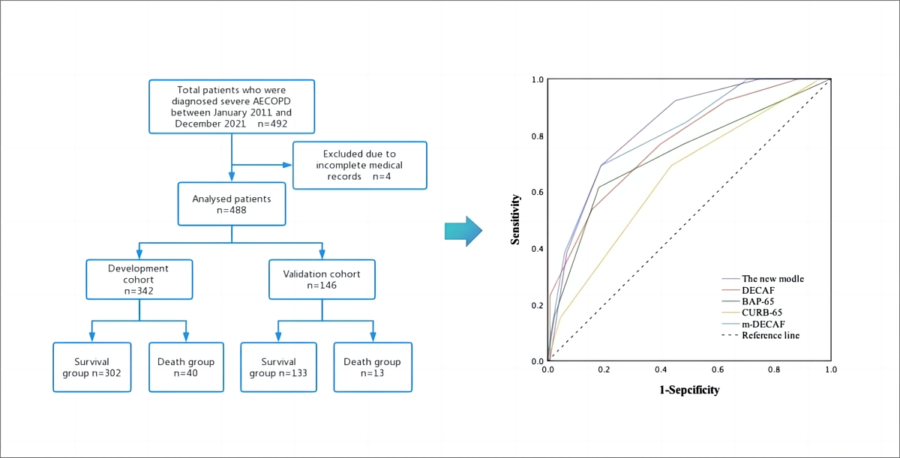

Predictive score for in-hospital mortality in patients with severe acute exacerbations of chronic obstructive pulmonary disease
DOI: 10.5114/aoms/191299
Arch Med Sci 2025;21(2):442-450
Notes:
Introduction
Chronic obstructive pulmonary disease (COPD) has shown a rising trend in morbidity and mortality over the years, leading to a growing economic burden globally. The aim of this study was to establish a predictive score for assessing the risk of death in patients with severe acute exacerbations of COPD (AECOPD) to help clinicians evaluate the condition and prognosis of patients.
Material and methods
Patients hospitalized for severe AECOPD were consecutively included. All patients were randomly assigned to the developmental and validation cohorts in a 7 : 3 ratio. We identified independent prognostic factors for in-hospital mortality in the development cohort by univariate analysis and multivariate logistic regression analysis. In the validation cohort, the predictive power of the new score was verified and compared to the other four scores.
Results
A total of 488 patients with severe AECOPD who were hospitalized between January 2011 and October 2022 were included. The mean age was 78.0 ±8.2 years and 361 (74.0%) of the patients were male. The development cohort included 342 patients, 40 of whom died during hospitalization. The five independent risk factors associated with in-hospital mortality according to multi-factorial regression analysis were white blood cell count (WBC) > 10 × 10<sup>9</sup>/l, lymphocyte count < 0.8 × 10<sup>9</sup>/l, age > 80 years, confusion, and chronic heart failure. In the validation cohort, the new prediction score had good predictive power (AUC = 0.826, 95% CI: 0.724–0.928) and performed more strongly than other clinical prediction scores.
Conclusions
The new predictive score is a simple and effective way to predict mortality in hospitalized patients with severe AECOPD.

