Slide 1
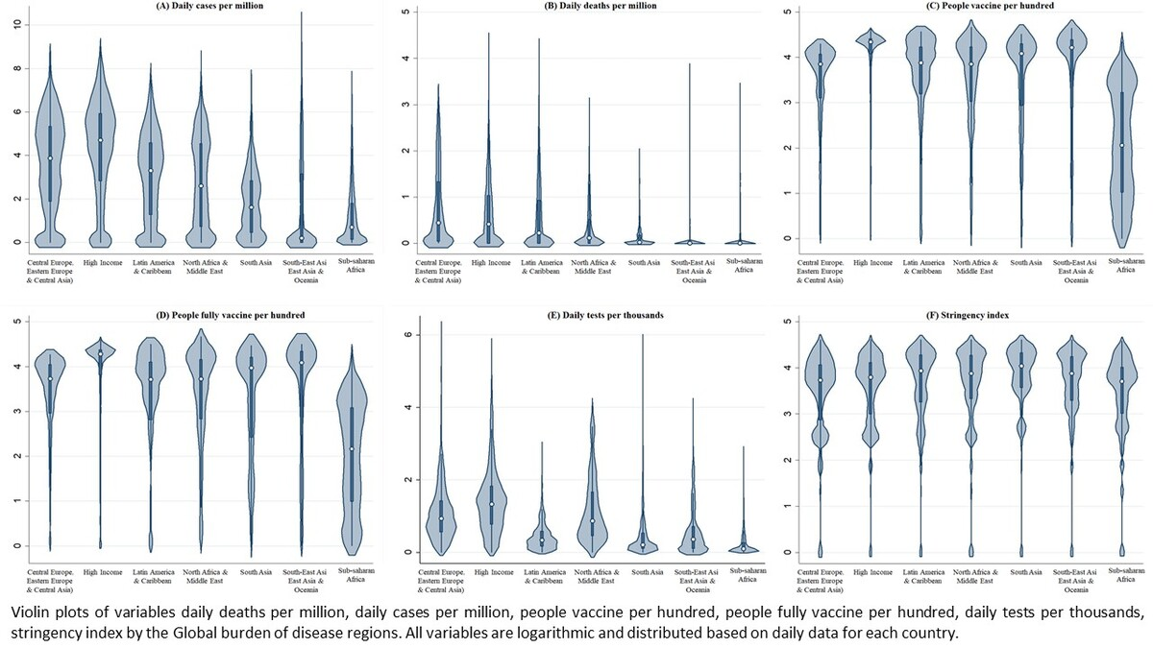

The role of vaccination, testing, and public restriction policies in COVID-19 mortality and incidence: insights from Global Burden of Disease regions
DOI: 10.5114/aoms/191563
Arch Med Sci 2025;21(4):1299-1309
Notes:
Introduction
This study aimed to examine the impacts of vaccination, testing, and government policies on COVID-19 mortality and incidence rates and compare these strategies’ effectiveness across the seven super regions of the Global Burden of Disease (GBD) study.
Material and methods
This study used data from January 3, 2020, to March 29, 2023. The incidence and mortality indices were calculated using “daily cases” and “daily deaths” and selected as dependent variables. Vaccination, COVID-19 tests, and strictness of a government’s policy were explored using corresponding metrics.
Results
Daily cases were four times higher in the high-income (HI) region (371.1) than those in the Latin America and Caribbean region (98.3), but the mortality rate was similar (1.5). The number of vaccinated people did not consistently reduce the mortality across all GBD regions. However, full vaccination was associated with decreased mortality in all regions except Central, Eastern, and Southeastern Europe and Central Asia (CEEECA). Regarding daily testing, a favorable correlation was observed between daily deaths on a global scale, excluding Southeast Asia, East Asia, and Oceania. Overall, vaccination coverage and government policies were effective in reducing COVID-19 mortality and incidence rates. However, only the HI region showed a negative association between the COVID-19 stringency index and both incidence and mortality rates.
Conclusions
Full vaccination significantly reduced COVID-19 mortality globally, except in the CEEECA region. The HI region showed lower incidence and mortality rates with stricter government measures. Effective vaccination programs and policies are crucial, emphasizing the need for strengthened international cooperation in future pandemics.

