Slide 1
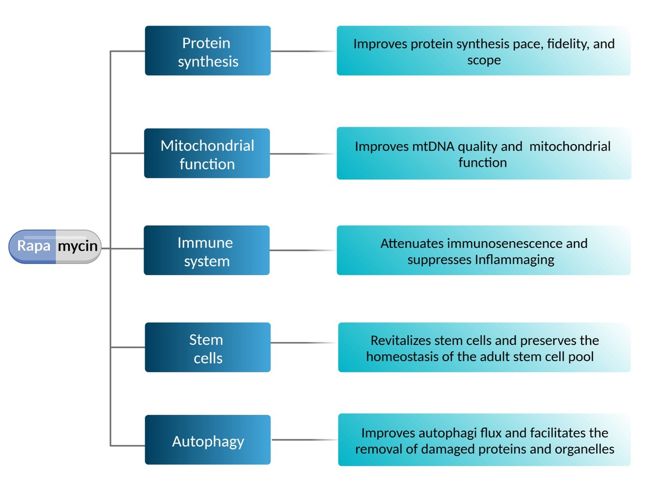

Impact of rapamycin on longevity: updated insights
DOI: 10.5114/aoms/191565
Notes:
The gradual accumulation of varying detrimental alterations during the aging process within cells and tissues contributes to a progressive decline in their functionality, which may ultimately result in death. The licensed mammalian target of rapamycin (mTOR) inhibitor rapamycin, also known as sirolimus, has recently become a promising option for anti-aging applications. Through in vitro and in vivo assessments, numerous scientific reports have illustrated diverse biochemical and clinical aspects of rapamycin’s pharmacological effects in ameliorating aging-related changes and expanding longevity. Nevertheless, its clinical application has been impeded by severe adverse effects, which might be addressed by implementing an appropriate therapeutic regimen. In this regard, integrating updated insights and uncovering essential benefits and drawbacks of rapamycin as a geroprotective drug are critical for conducting further preclinical research and well-organized clinical trials, and facilitating translation to clinical practice. The present review highlights the recent findings on the role of rapamycin in improving organ health and postponing aging-related processes.

