Slide 1
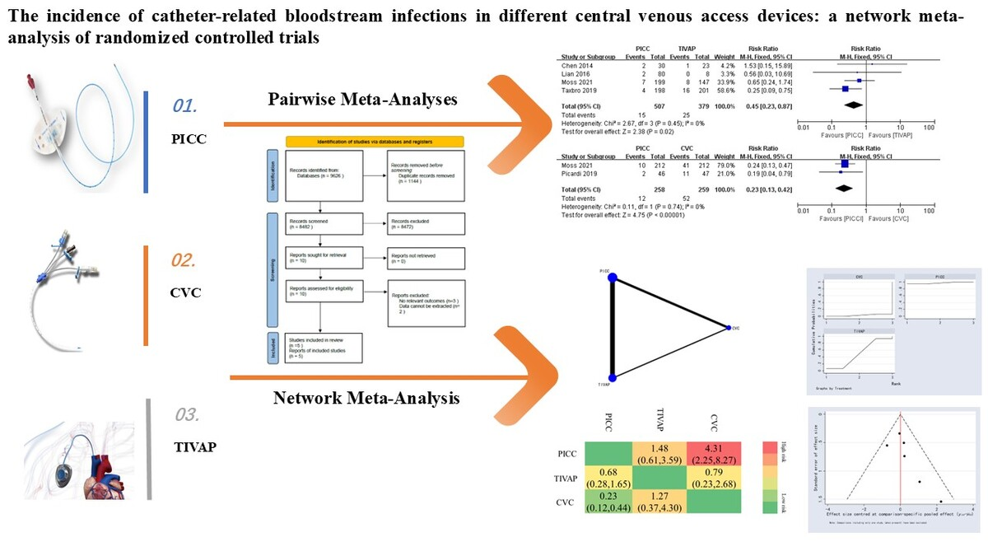

The incidence of catheter-related bloodstream infections in different central venous access devices: a network meta-analysis of randomized controlled trials
DOI: 10.5114/aoms/191725
Arch Med Sci 2025;21(4):1405-1413
Notes:
Introduction
Direct paired meta-analyses and network meta-analysis were conducted to compare the incidence of catheter-associated bloodstream infections (CRBSIs) in different types of central venous access devices (CVADs).
Material and methods
The PubMed, EMBASE, Web of Science, Cochrane, CNKI and CBM databases were systematically searched from inception to May 31, 2024 for randomized controlled trials (RCTs) comparing the incidence of CRBSIs across various types of CVADs. Literature screening, data extraction, and risk bias evaluation were all independently conducted by two individuals. Direct paired meta-analyses and network meta-analysis were performed using RevMan 5.3 and Stata 14.0 software, respectively.
Results
A total of five studies were included. Paired meta-analyses revealed that the incidence of CRBSIs was lower in the peripherally inserted central catheter (PICC) group compared to the central venous catheter (CVC) group (RR = 0.23, 95% CI (0.13–0.43), p < 0.00001). The incidence of CRBSIs in the PICC group was observed to be lower compared to that in the totally implantable venous access port (TIVAP) group (RR = 0.45, 95% CI (0.23–0.87), p = 0.02). Descriptive analysis revealed a higher incidence of CRBSIs in the CVC group compared to the TIVAP group (RR = 2.97, 95% CI (1.65–5.17), p = 0.0002). The network meta-analysis revealed a significantly lower incidence of CRBSIs in the PICC group compared to the CVC group. However, no statistically significant differences were observed in other comparisons. Based on the cumulative ranking curve test, the incidence of CRBSIs in various CVADs was ranked as follows: PICCs (97.20%) > TIVAPs (50.00%) > CVCs (2.80%).
Conclusions
The available evidence suggests that PICCs exhibit the lowest incidence of CVADs, followed by TIVAPs. Therefore, PICCs should be prioritized when selecting CVADs.

