Slide 1
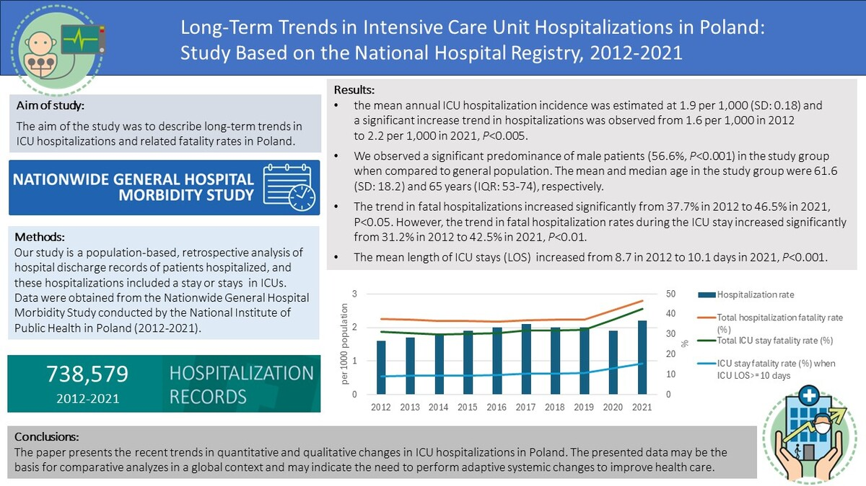

Long-term trends in intensive care unit hospitalizations in Poland: a study based on the National Hospital Registry, 2012–2021
DOI: 10.5114/aoms/191726
Arch Med Sci 2025;21(6):2406-2413
Notes:
Introduction
Intensive care unit (ICU) hospitalizations are one of the major burdens on the healthcare system, and they may be related to high risk of in-hospital fatality. The aim of the study was to describe long-term trends in ICU hospitalizations and related fatality rates in Poland.
Material and methods
It was a population-based study based on 738,579 ICU hospitalization records in 2012–2021.
Results
Based on the hospital registry and data on the general population, the mean annual ICU hospitalization incidence was estimated at 1.9 per 1,000 (SD = 0.17). A significant increasing trend in hospitalizations was observed from 1.6 per 1,000 in 2012 to 2.2 per 1,000 in 2021, p < 0.005. We observed a significant predominance of male patients (56.6% p < 0.001) in the study group when compared to the general population. The mean and median age in the study group were 61.6 (SD = 18.2) and 65 years (IQR: 53–74), respectively. Linear regression analysis demonstrated a significant upward trend in fatal hospitalizations from 37.7% in 2012 to 46.5% in 2021, p < 0.05. Similarly, fatal ICU stays increased significantly from 31.2% to 42.5% over the same period, p < 0.01. The mean length of ICU stays increased from 8.7 in 2012 to 10.1 days in 2021, p < 0.001.
Conclusions
The paper presents the recent trends in quantitative and qualitative changes in ICU hospitalizations in Poland. The presented data may constitute the basis for comparative analyses in a global context. Our findings suggest that adaptive systemic changes are necessary to improve health care.

