Slide 1
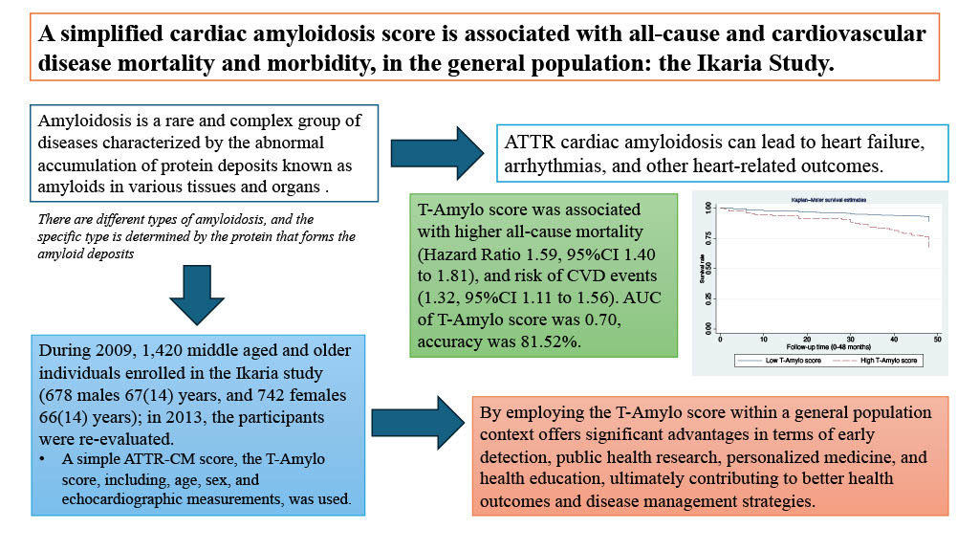

A simplified cardiac amyloidosis score predicts all-cause and cardiovascular disease mortality and morbidity in the general population: the Ikaria Study
DOI: 10.5114/aoms/192050
Arch Med Sci 2025;21(5):1801-1810
Notes:
Introduction
Transthyretin amyloid cardiomyopathy (ATTR-CM) is an under-appreciated disease. The aim of this study was to evaluate the T-Amylo score, which is related to ATTR-CM, and its association with all-cause and cardiovascular disease (CVD) morbidity and mortality, in the general population.
Material and methods
The T-Amylo score (range: 0–11) is based on clinical and echocardiographic features (age and gender, interventricular septal end diastole [IVSd] thickness ≥ 16 mm, low QRS interval voltage, and carpal tunnel syndrome) that have been previously introduced in clinical practice. During 2009, 1,420 middle-aged and older inhabitants agreed to enroll in the Ikaria study (678 males aged 67 (14) years, and 742 females aged 66 (14) years); in 2013, the participants were re-evaluated.
Results
Survival analysis revealed that the T-Amylo score was associated with all-cause mortality (hazard ratio = 1.59, 95% CI: 1.40 to 1.81), and the risk of combined CVD events (1.32, 95% CI: 1.11 to 1.56), after various adjustments were made. ROC analysis revealed that the AUC of T-Amylo score was 0.70, the accuracy was 81.52%, and the net-reclassification indices suggested better reclassification performance than its components. Stratifying by age group, the score predicts all-cause and CVD mortality and morbidity only among individuals aged > 65 years.
Conclusions
The prognostic value for CVDs of the T-Amylo score observed in this study seems promising, suggesting its applicability in the general population.

